Slide 1
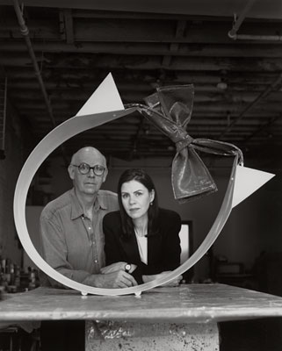
Claes Oldenburg
1929-Present
Born in Stockholm, Sweden
Claes Oldenburg
and Coosjevan Bruggen, his wife

Slide 2
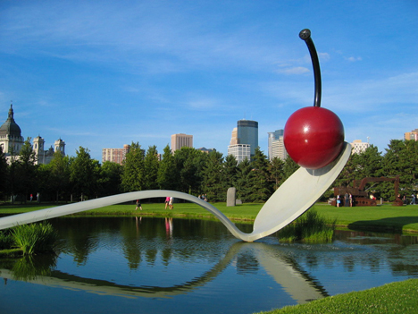
“Spoonbridge and Cherry”, 1988
Claes Oldenburg is a Swedish sculptor, best known for his public art installations typically featuring very large replicas of everyday objects.

Slide 3
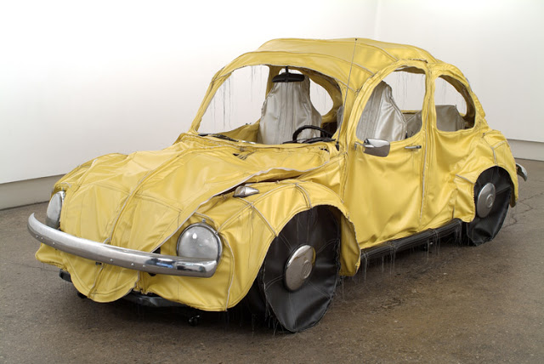
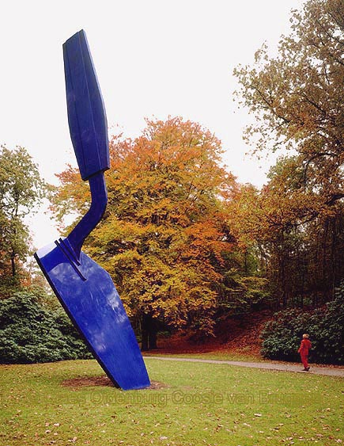
Oldenburg saw himself as a realist, not as an abstract artist.
He felt art must relate to the realities of everyday life.
Yet he took objects from the real world and placed them out of context, making them soft when they should be hard, large when they should be small.
“Trowel I”, 1971-76

Slide 4
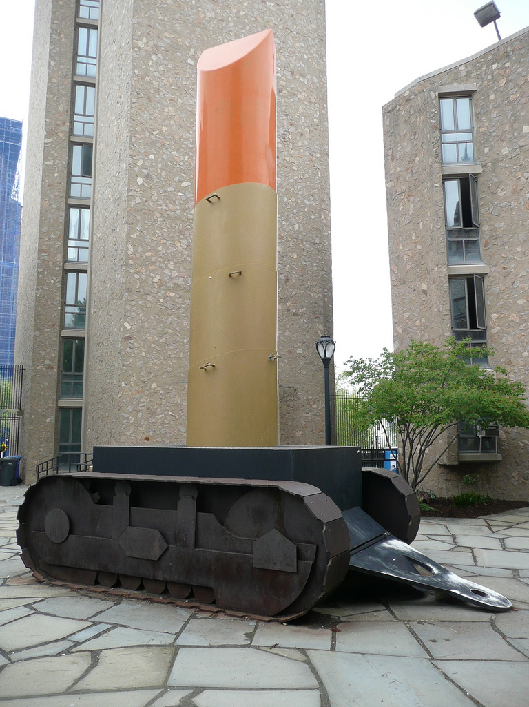
This colossal structure is an interactive soft sculpture of a tube of lipstick which would deflate unless a participant re-pumps air into it.
He made it in partnership with his late wife, Coosjevan Bruggen.
“Lipstick (Ascending) on Caterpillar Tracks”, 1969-1974

Slide 5
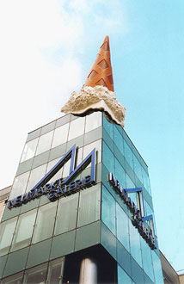
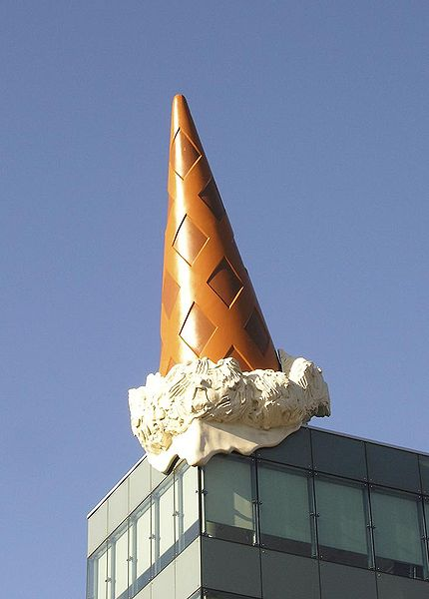
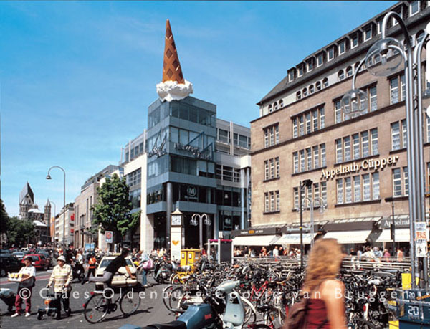
“Dropped Cone”, 2001

Slide 6
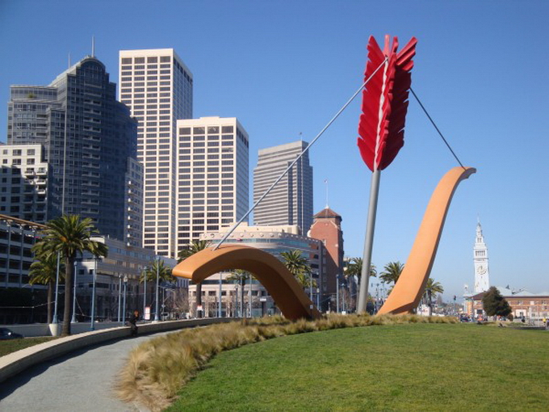
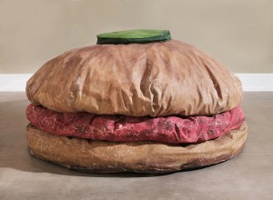
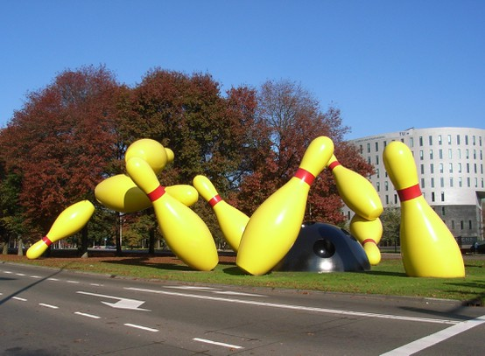
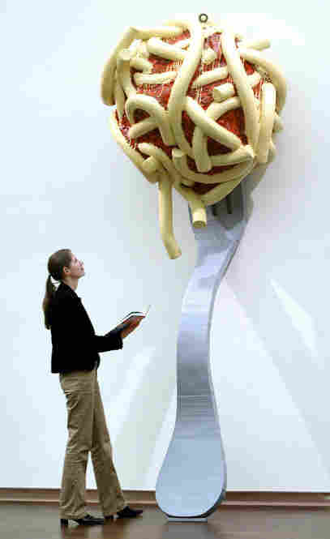
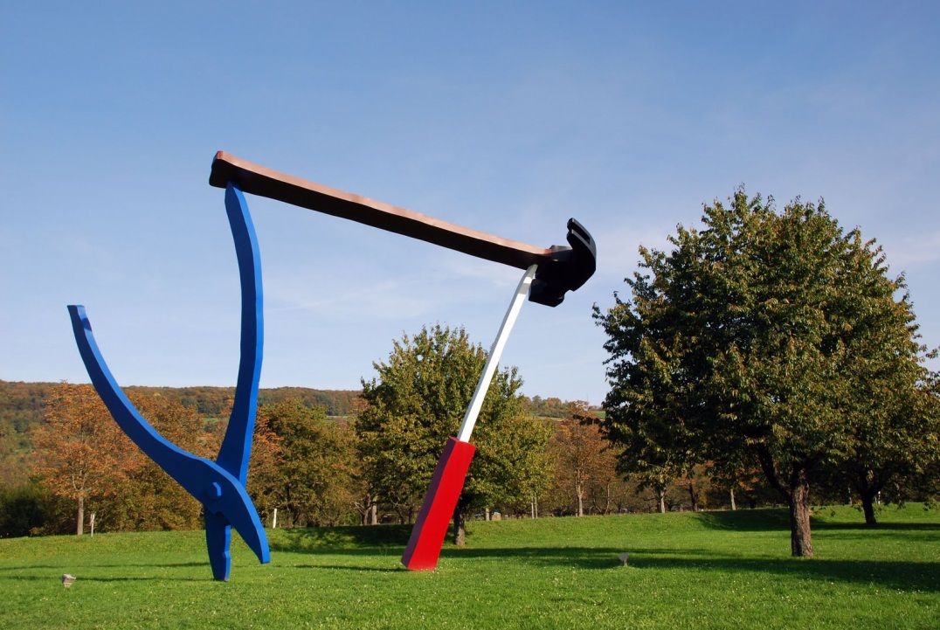
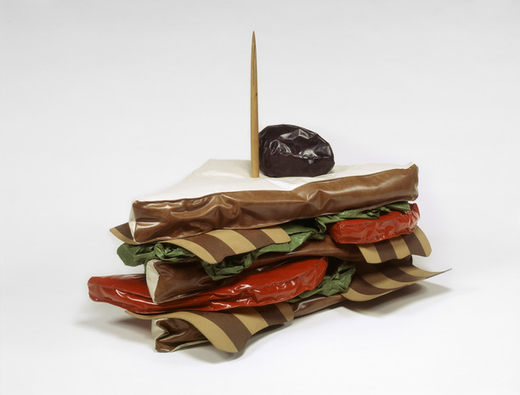
“Flying Pins”, 2000
“Floor Burger”, 1994
“Leaning Fork with Meatball”, 1994
“Giant BLT”, 1963

Slide 7
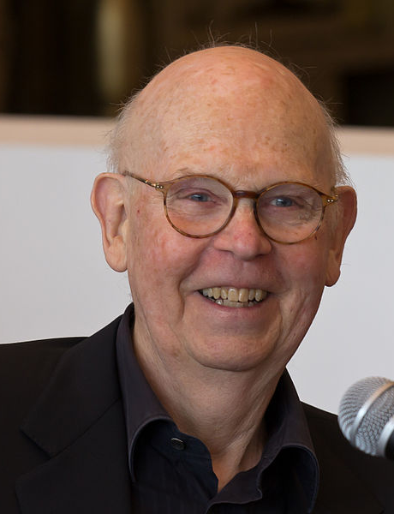
What is one thing that you learned today about Claes Oldenburg?

Slide 8
“Hold the Pickle” Burger
Label a piece of black construction paper with your name.
Create a large replica of a burger.
Be sure to make it larger than it usually would appear.
Imagine other food items that you normally wouldn’t find in a burger.
On your piece of paper, start with gluing a ½ paper plate.
Use green tissue paper for lettuce, brown paper for buns and meats, red paper for tomatoes, yellow paper for cheese, etc. Don’t forget to add the pickle with the toothpick.
Use markers and colored pencils to add detail to your food items. Use hole punch to add holes to your cheese.
BE CREATIVE.

Slide 9
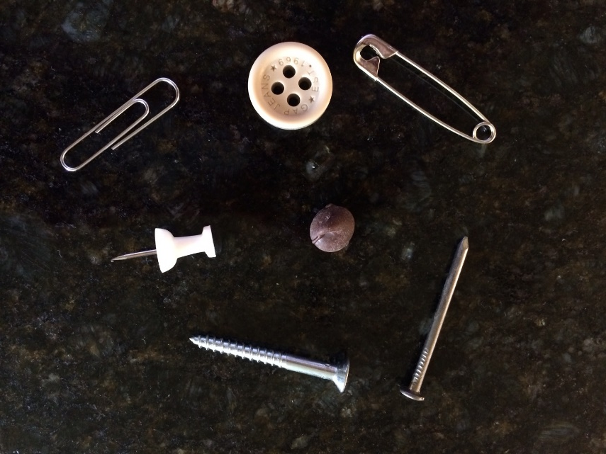
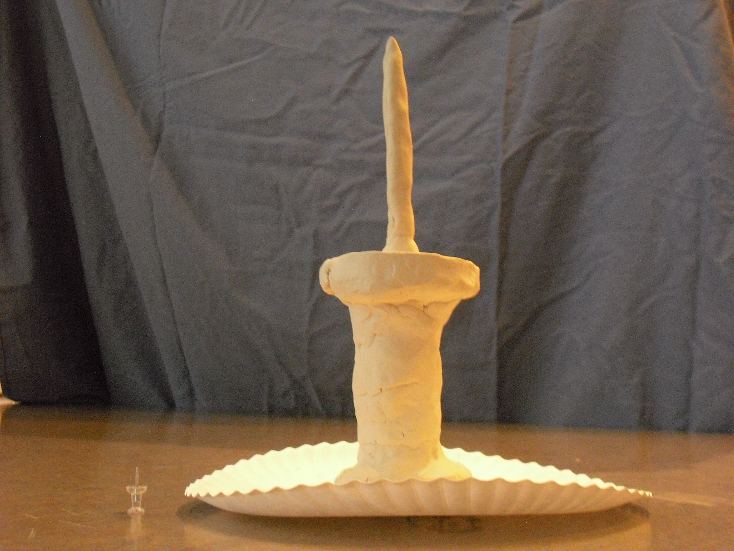
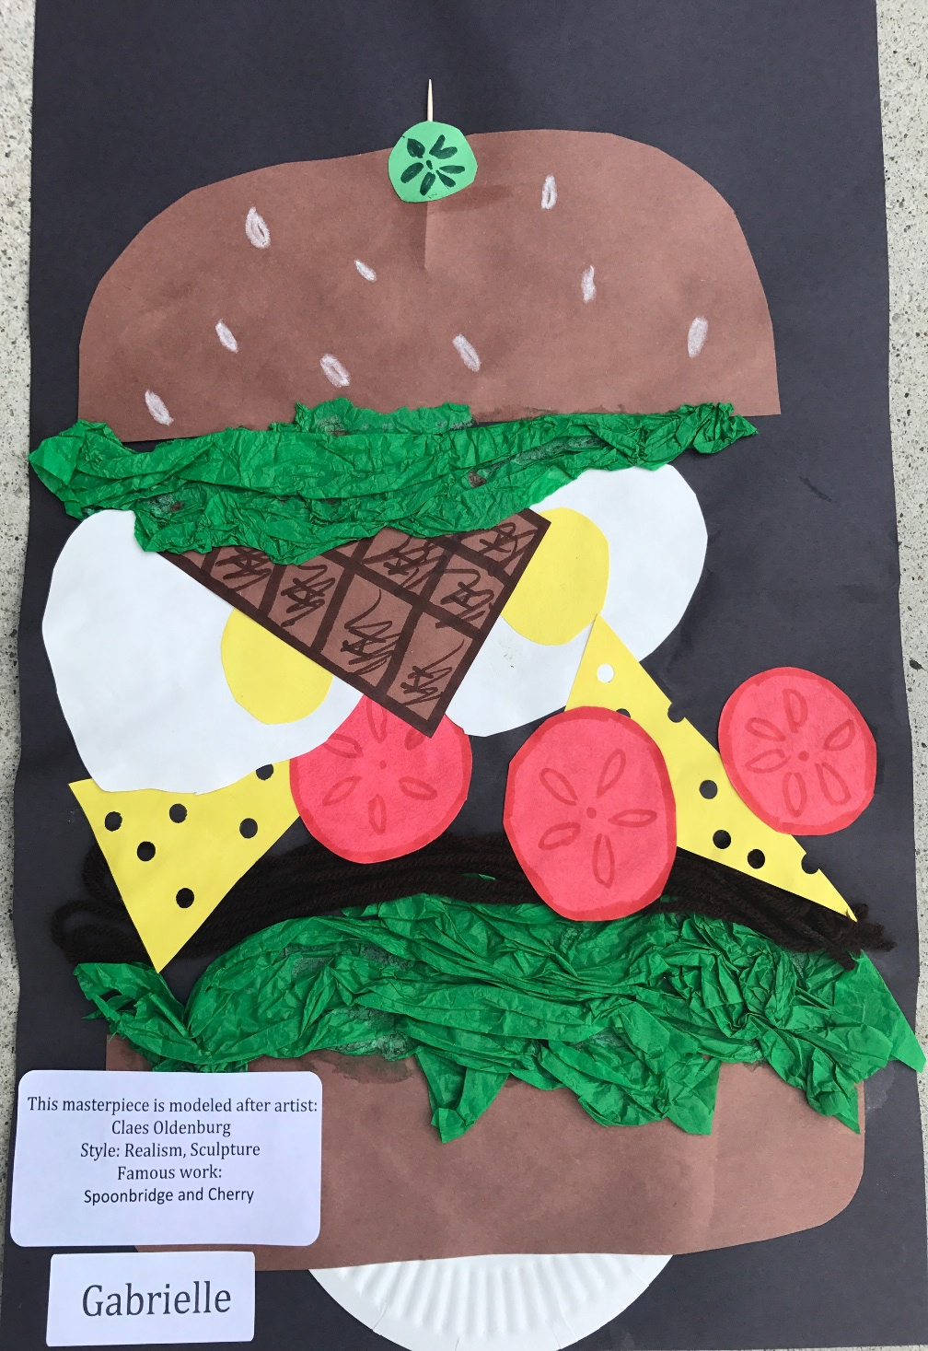
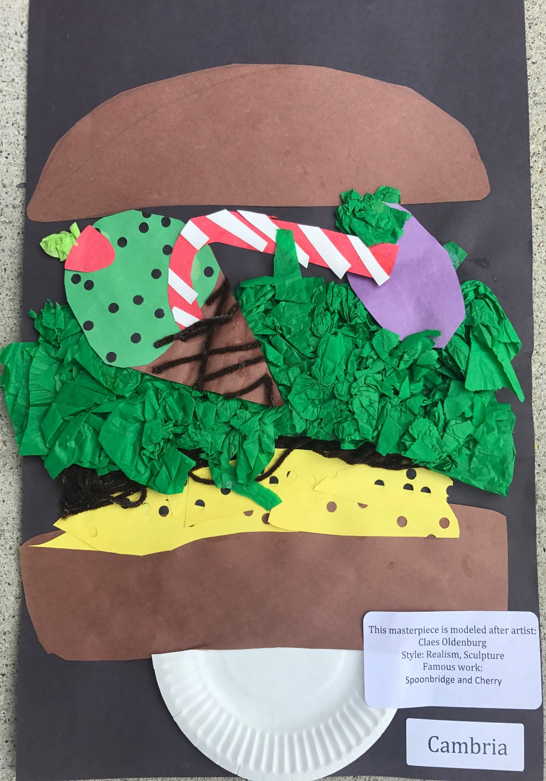
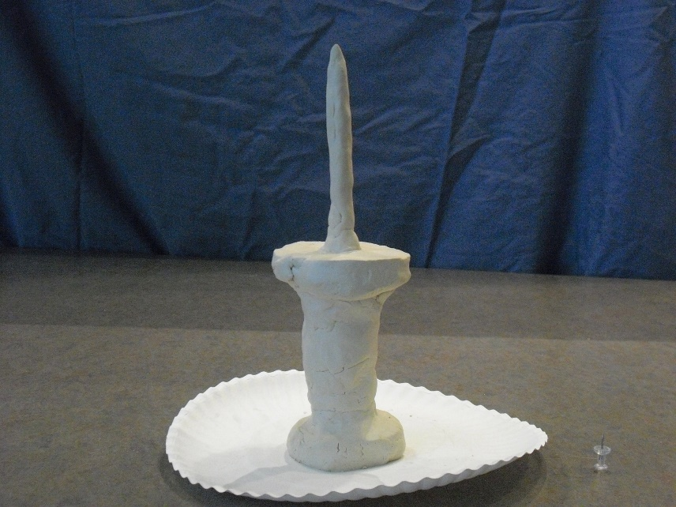
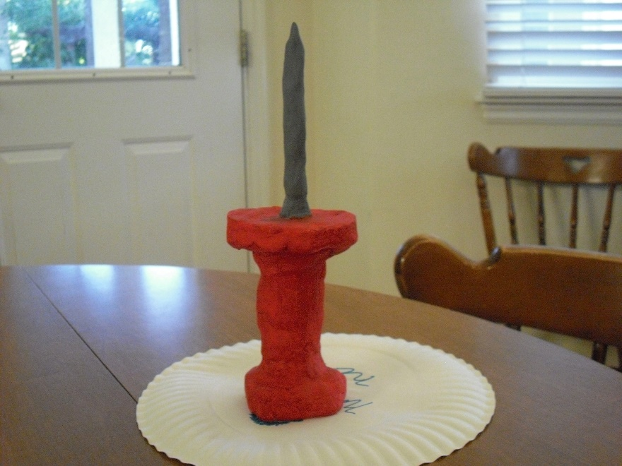
Sample items to sculpt
Raw clay product, sculpted

