Slide 1
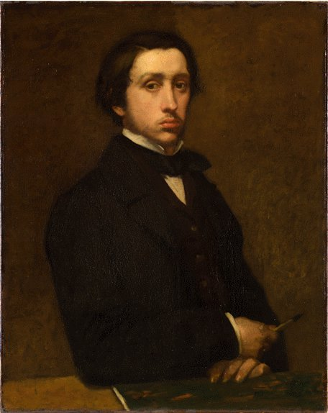
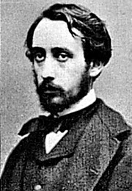
Edgar Degas (pronounced DAY-GAH) 1834-1917 Born in Paris, France
Self Portrait, 1855 (about 20 years old)

Slide 2
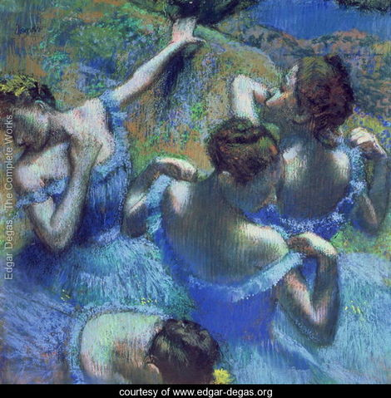
Edgar Degas was a French, Impressionist painter.
Impressionist artists painted what they saw and felt, impressions, instead of things as they really looked.
Impressionist painters used very little detail, but instead used quick dashes of the paintbrush to light up scenes of everyday life.
“Blue Dancers”, 1899.
Degas used paint, charcoal pencil and colored chalk to create his paintings.

Slide 3
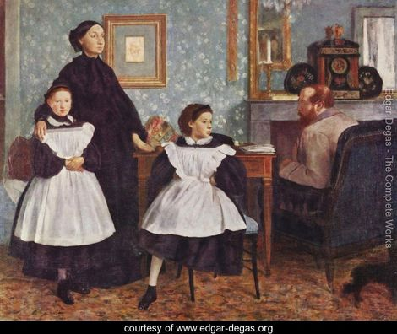
Degas came from a wealthy family.
At age 19, he started studying law, but soon left to pursue art.
Many of his early paintings were portraits of himself and his family.
The painting on the left shows Edgar’s relatives in Italy. He lived with them while studying the master artists of his time. What is the mood of the painting? Does the family seem happy or unhappy?
“The Bellelli Family, 1858-67

Slide 4
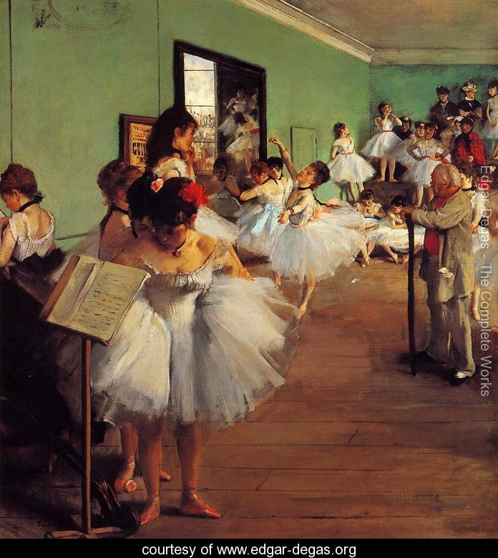
Degas studied how to show movement in his art.
Some of his most famous paintings showing movement are of dancers.
Notice how the ballerina’s skirt appears to still be moving through the air as she dances?
“The Dance Class II”

Slide 5
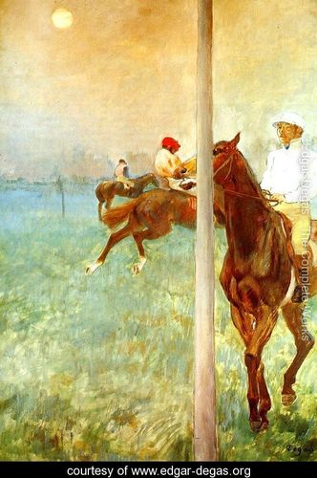
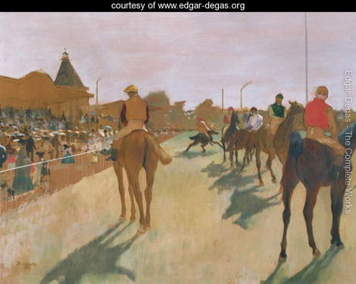
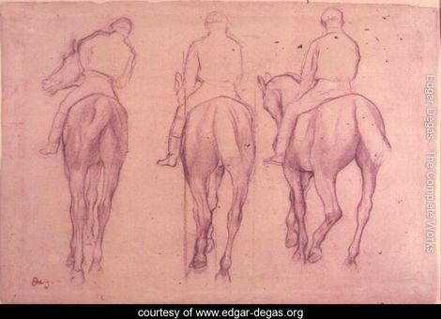
Edgar Degas was also a great draftsman, meaning that he could draw very well. He often would draw his subjects before painting them.
Having friends that lived near the racetrack, Edgar drew and painted many pictures of horses with their jockeys.
The painting, “Jockeys Before the Race”, (left) shows how Degas liked to paint from different view points.
“Racehorses before the Stands”, 1866-1868
“The Jockeys”

Slide 6
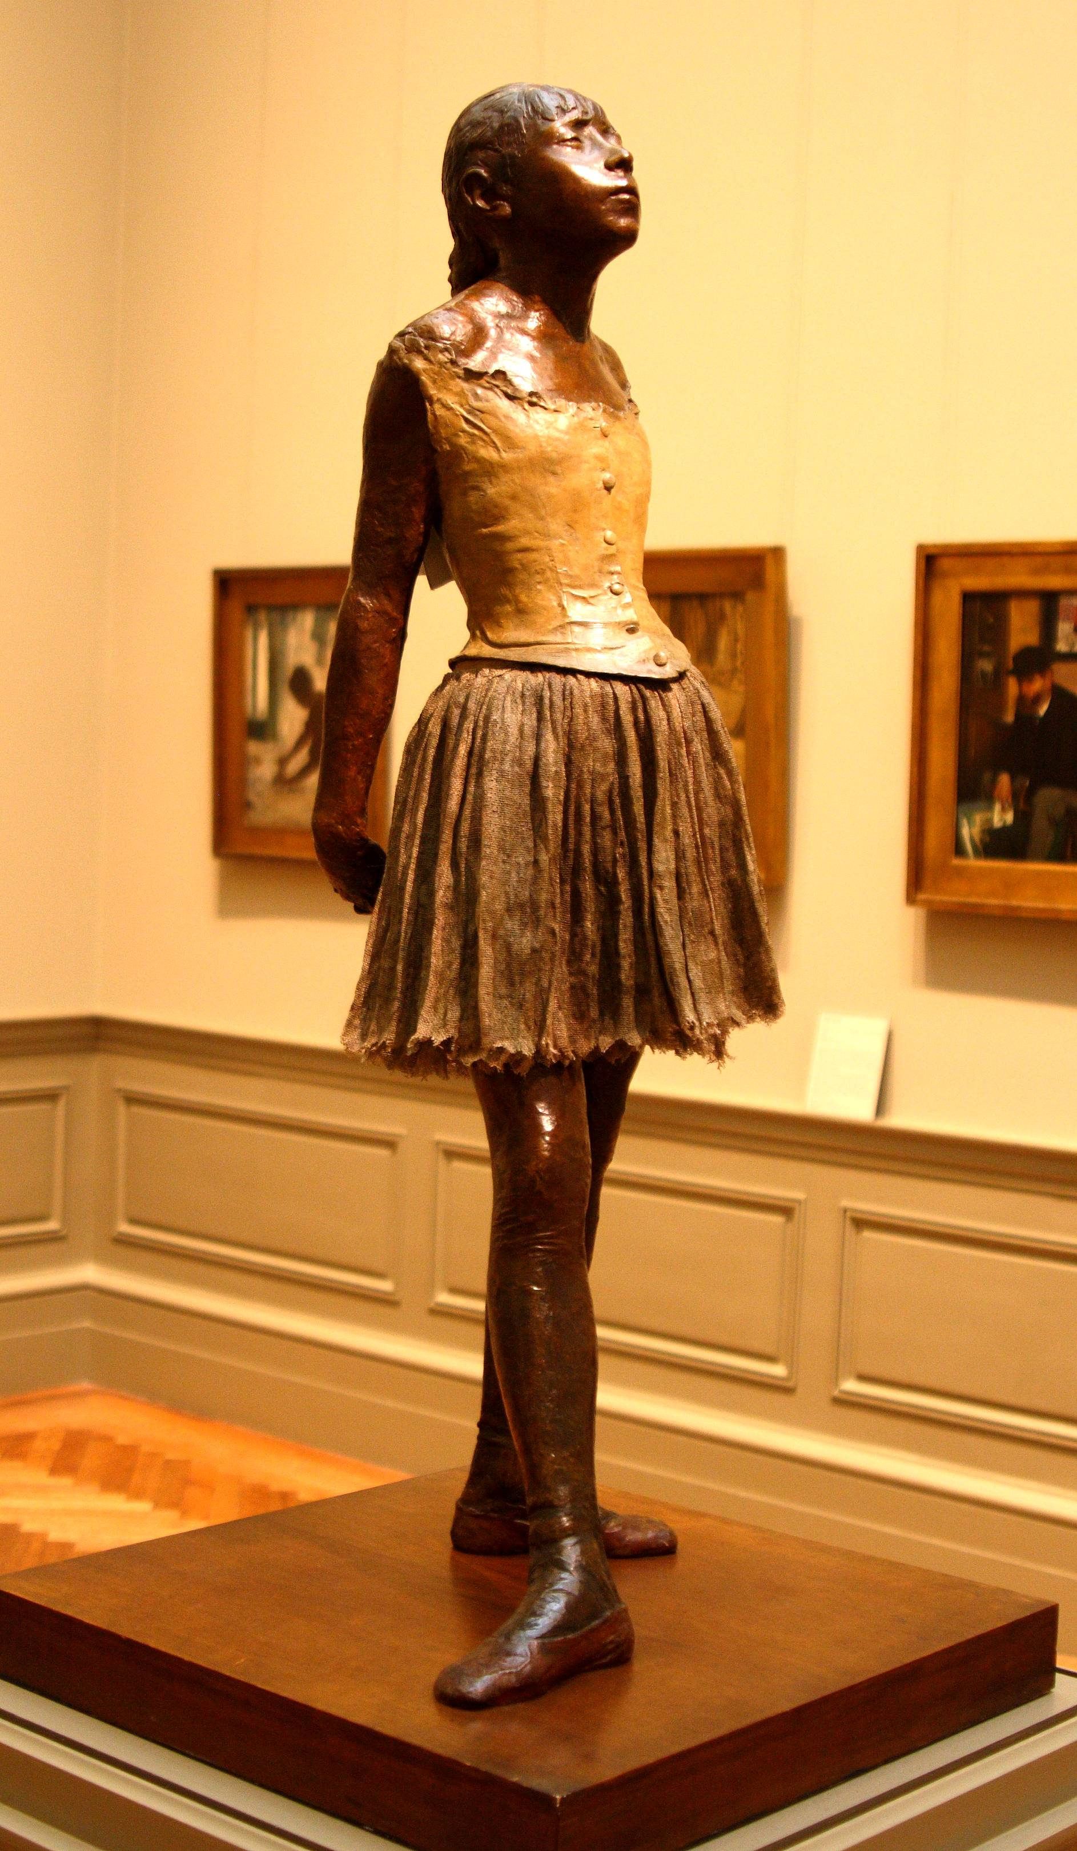
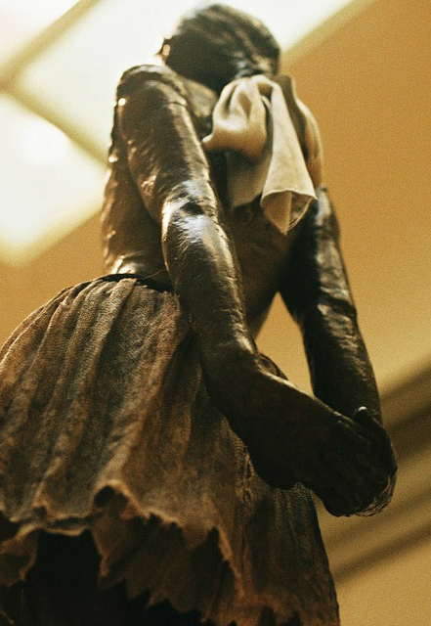
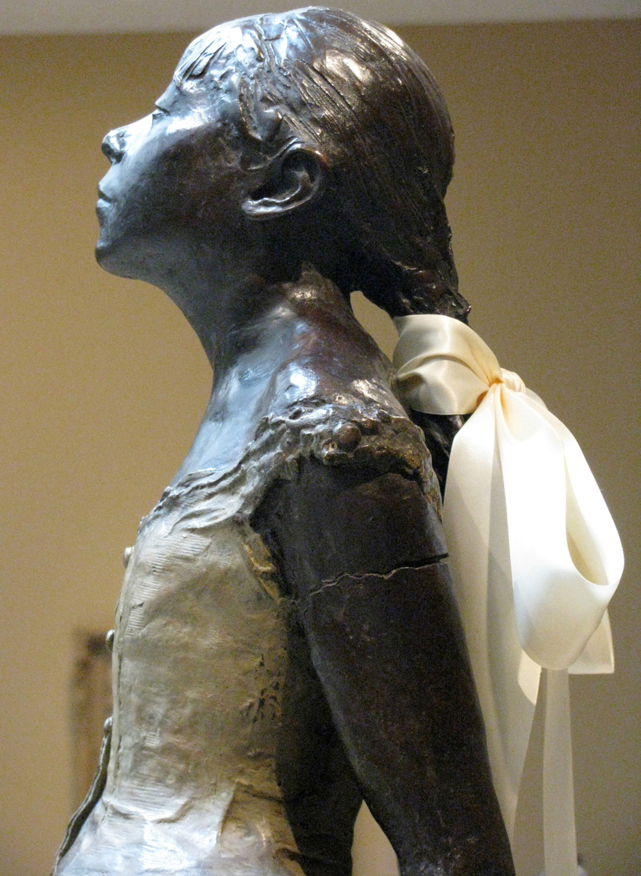
Degas often used sculpture to generate ideas for his paintings.
This sculpture Degas created is the only one he ever put on exhibit.
His sculptures were made from wax and clay.
This dancer is just a little over 3 feet tall and has real hair, a real ballet dress and shoes.
“The Little Fourteen-Year-Old Dancer”,
about 1880.

Slide 7
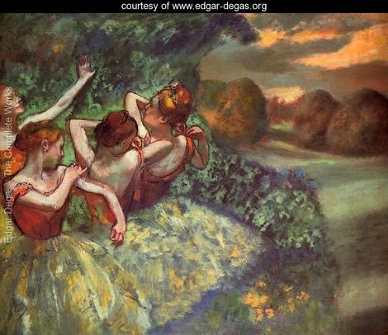
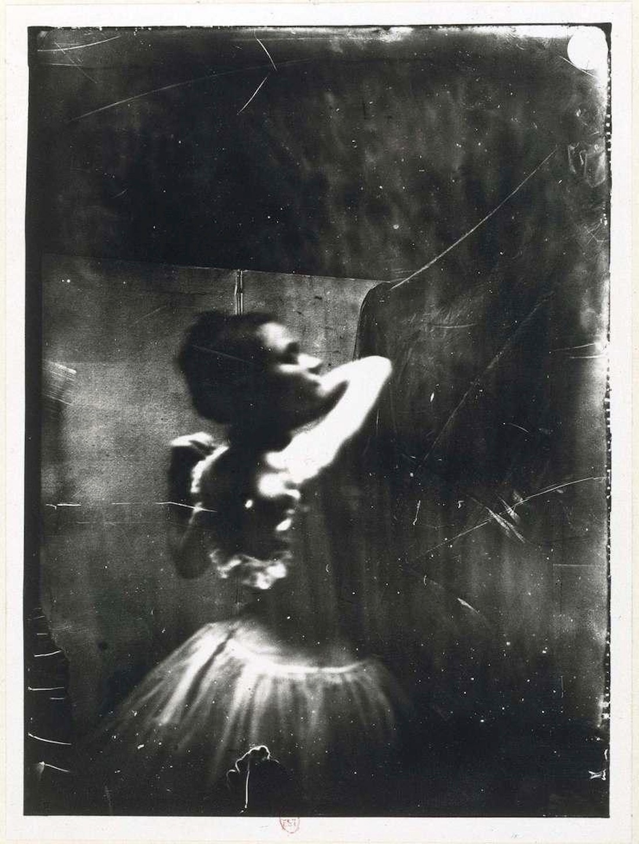
During Degas’ lifetime, photography was invented.
Degas used the camera to take pictures of his subjects and then traced over them to perfect his drawings.
The subjects in, “Four Dancers”, appear to have a real life quality about them even though they are actually an artists’ creation.

Slide 8
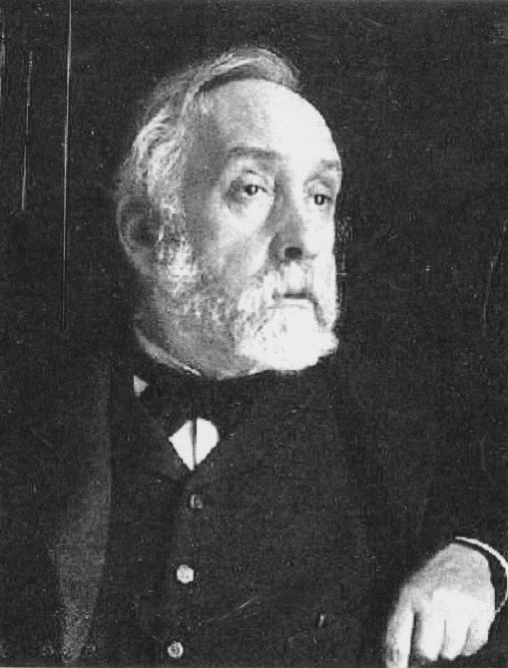
What is one thing you learned today about Edgar Degas?

Slide 9
Degas in Motion
Put your name on the back of your paper.
On your index card, draw an object that moves or use pre done templates . Make sure it isn't too detailed and it takes up most of the space on your card. Some examples are a racecar, a butterfly, an alien spaceship, a bug or a ballerina like Degas painted.
Use a Sharpie to outline your object and fill in some of the details with the Sharpie. These will be colored in later.
Cut out your object with scissors.
Ask yourself, how would this object move?
Is your motorcycle taking a jump? Is the butterfly moving diagonally across the page? Is your alien spaceship taking off to go back to outer space? Is your ballerina dancing across the page?
Place your object onto the page and trace around it with crayon. Then move the object a bit and trace it again (you can use the same color crayon or a different color). The tracings should overlap slightly and move across the page in the way the real object would move. Trace your shape about 5 times. Make sure the crayon lines are nice and thick (you may need to go over them again).
Once you are done tracing your object, have a volunteer help you tape your paper to your desk with masking tape.
Pick a color (watered down Crayola paint) and paint a nice wash over the entire surface of your paper. The crayon lines will resist the paint so you'll be able to see them still.
While this is drying, use colored pencils to color in your object you drew on the index card.
When the background is dry, use a glue stick (or a volunteer can use rubber cement) to attach the colored in object to the background along the path of movement.
It now looks as though your object is moving across the page!

Slide 10
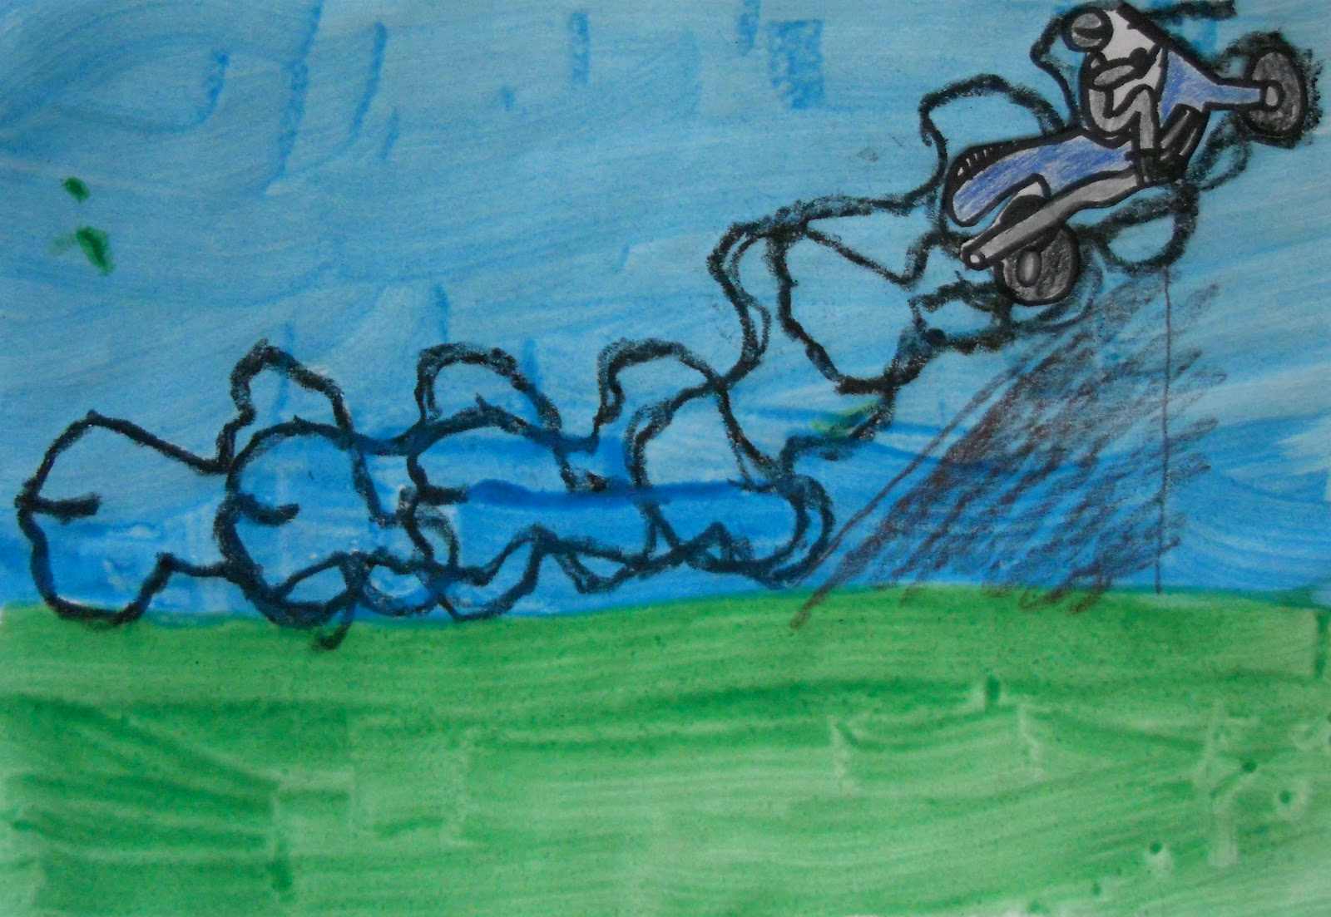
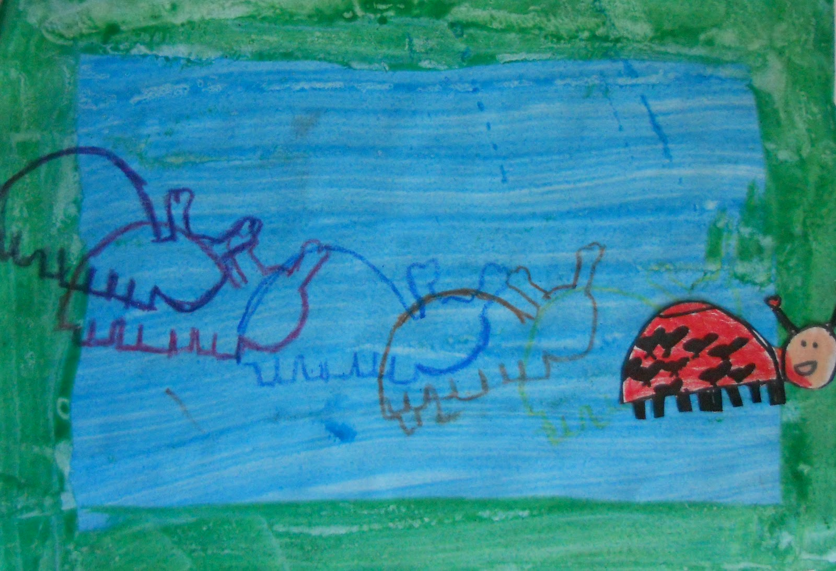
Art project and sample art pieces from createartwithme.blogspot.com

