Slide 1
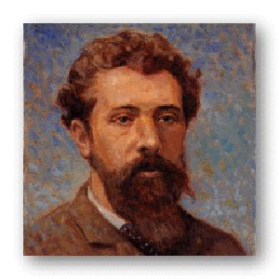
George Seurat (SIR-AH) 1859-1891 Born in Paris, France

Slide 2
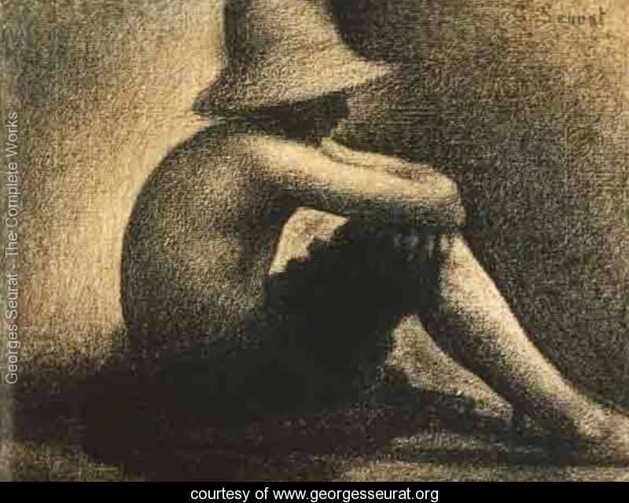
“Seated Boy With Straw Hat”
George studied art at age 19. He worked to master the art of black and white drawings.

Slide 3
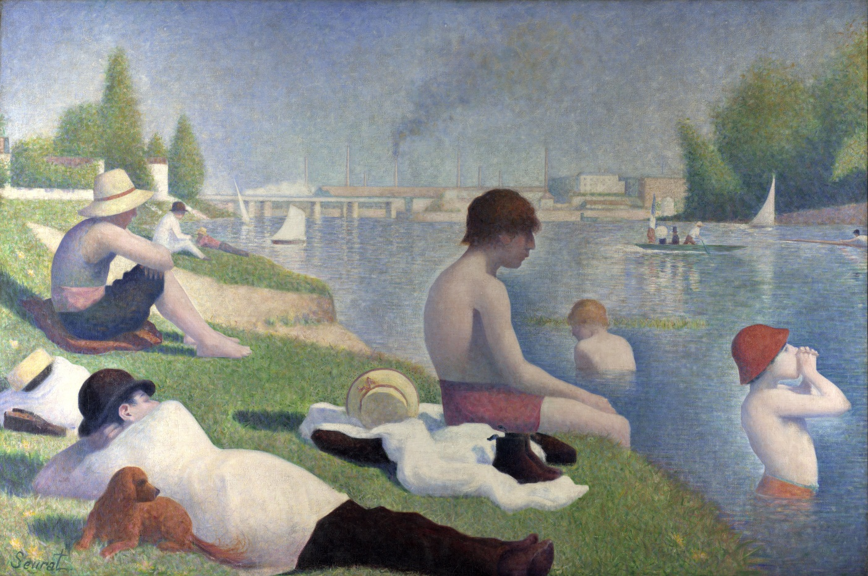
He spent the year 1883 on his first major painting, “Bathers at Asnieres” (pictured below).
George Seurat was an impressionist painter.
Impressionists painted impressions of what they saw and felt instead of things as they really looked. They worked to capture the way the light naturally reflected off of their subjects.

Slide 4
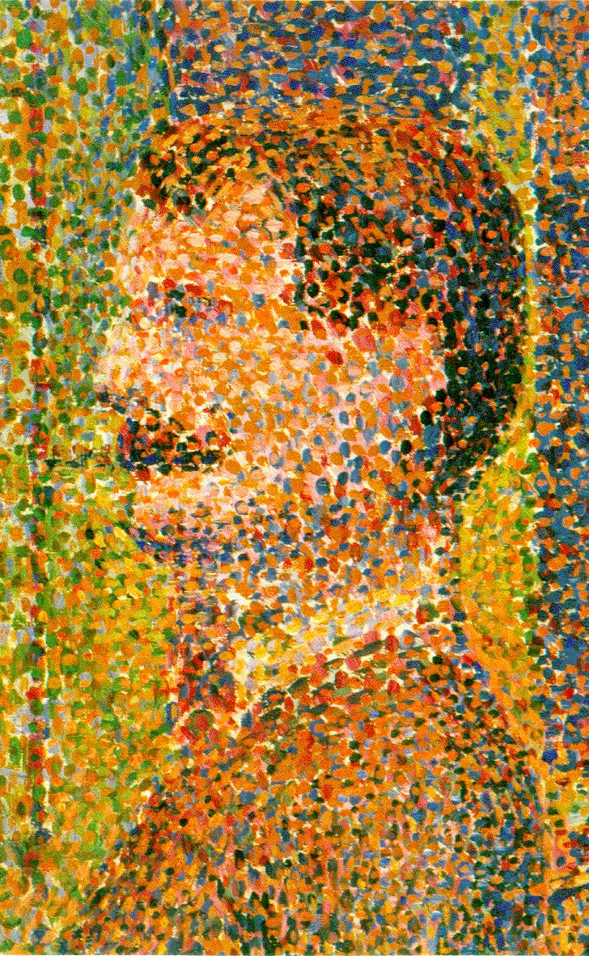
In 1884, Seurat developed “Pointillism”.
Pointillism is the application of paint in tiny dots across a canvas.
When looked at from a distance, the dots of color blend together making new colors and forming images.
Detail from “Circus Sideshow”
(“Parade de Cirque”), 1889, showing pointillism.

Slide 5
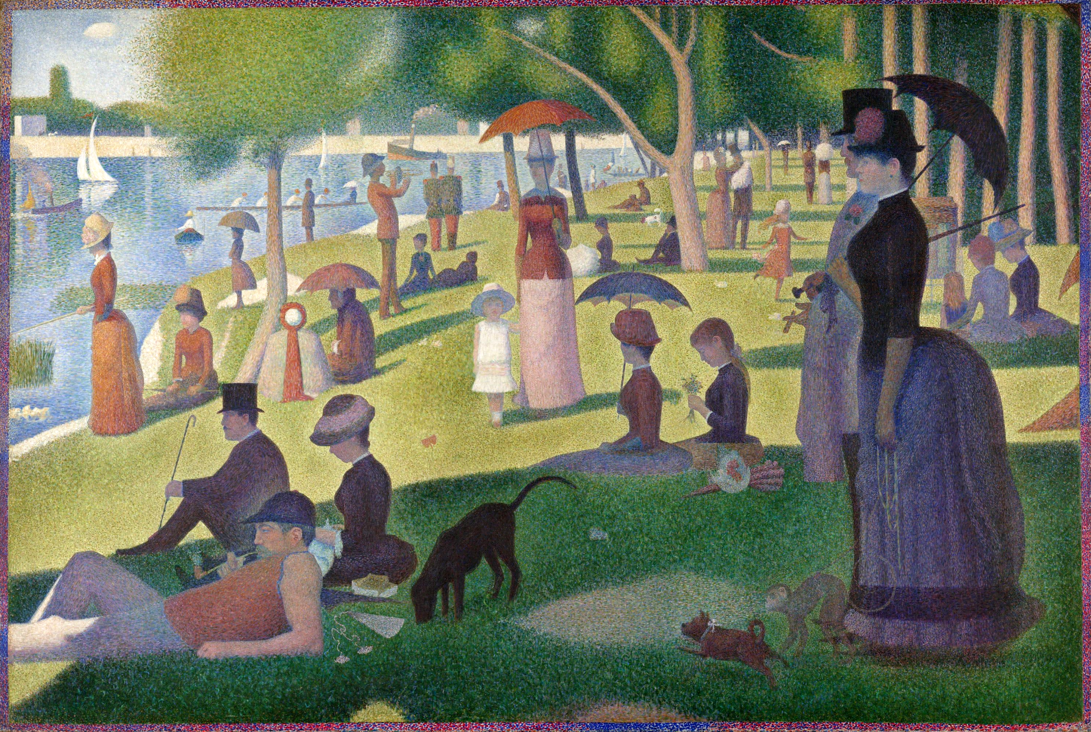
Seurat’s most famous pointillism work was “Sunday Afternoon on the Island of La Grande Jatte” (1886). This painting is 7 feet tall and nearly 10 feet across. It took Seurat nearly 2 years to complete.

Slide 6
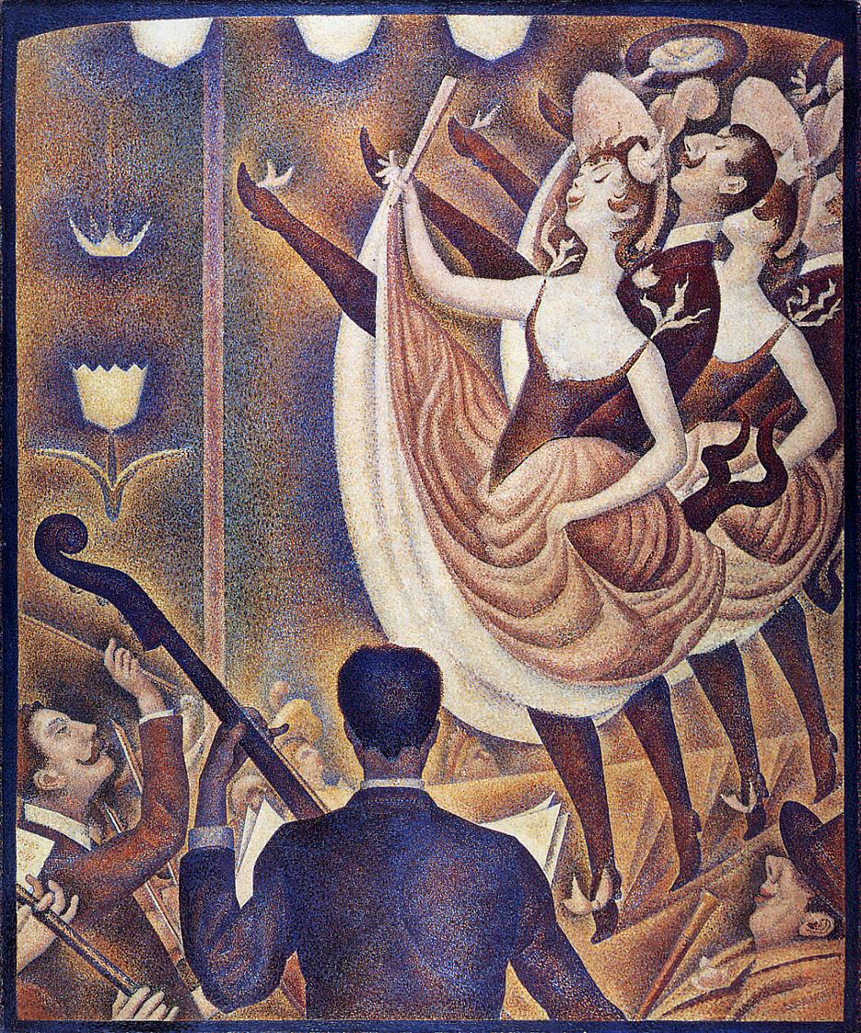
“Le Chahut”,
1889-1890

Slide 7
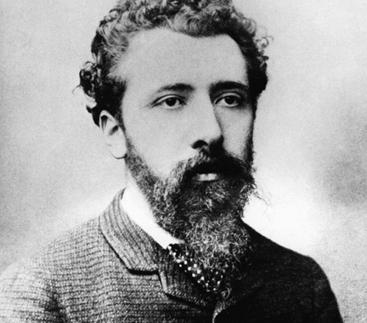
Who can say one thing that they learned about George Seurat today?

Slide 8
Pointillism Art
Put your name on the back of your paper.
Use a template or sketch a simple picture; like a house, a vase or a person.
Using Q-tips, paint your picture, only using dots.
Paint the dots closely together, blending the colors to give depth and texture to the picture.
Fill the entire page.

Slide 9
