Slide 1
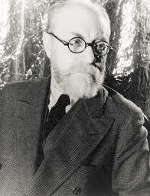
Henri Matisse (pronounced MAH-TEESS) 1869-1954 Born in Le Cateau-Cambrésis, France

Slide 2
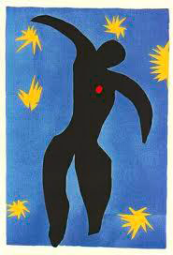
“The Jazz Icarus”

Slide 3
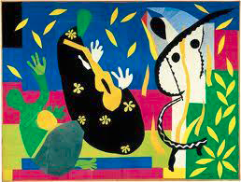
Matisse was a French artist.
Known primarily for his use of color as a painter and for his fluid, original drawings.
He was also a printmaker and sculptor.

Slide 4
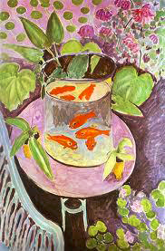
“Goldfish”, 1912

Slide 5
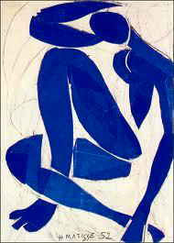
“Nu bleu II” (Blue Nude II), 1952
Gouache-painted paper cut-outs stuck to paper mounted on canvas.

Slide 6
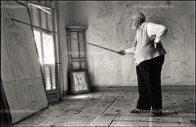
Some of the work done by Matisse was so large that he would have to use large walls and sticks to move the pieces around until he found them to be just right. Here he is sketching his designs on the walls prior to painting them in with color.

Slide 7
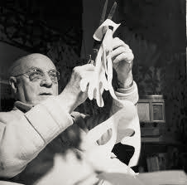
Matisse grew painfully ill and could not be moved from his wheelchair or bed. He could still cut images and have his secretary place them around the floor to find his designs.
He loved to cut the shapes to show texture in a design.

Slide 8
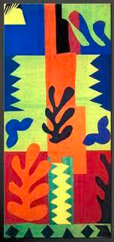
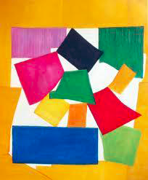
“The Snail”
“La Vis”

Slide 9
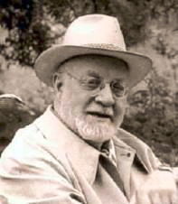
What is one thing that you learned about Henri Matisse today?

Slide 10
Seascape Collage
Choose 2 or 3 pre-cut pieces of construction paper. Make sure they are all different colors. These will be your ocean shapes.
Choose 2 or 3 different ocean objects to create with your scissors out of your construction paper. (See samples on slide #11)
Think about the shape in your mind before cutting. Try cutting the shape out with one continuous cut.
Set your ocean objects aside.
Select one large piece of construction paper in black, dark blue or light blue. This will be your ocean background. (See slide #12 for ideas)
Select another color (different than your background color) in black, dark blue or light blue for your ocean floor. This will just be a half sheet of construction paper. (See slide #12 for ideas)
Decide where to put your half sheet of paper. Looking at the samples on slide #12, you can create a ocean floor, wave patterns, or see how to create depth in the ocean-by using black on the ocean floor.
Use a variety of colors to cut sea kelp or sea weed. This will help frame your sea creatures/objects. Do you want them to be fat or thin? Tall or short?
Be creative! Add some negative space objects to your collage and put some objects in front of or behind your sea weed.
Lay everything out before you start to glue them down to make sure your collage is the way you want it to look.
When you are happy with your collage, use a glue stick to glue your objects to your paper.
Write your name on the back of your seascape!

Slide 11
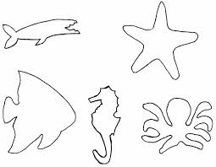
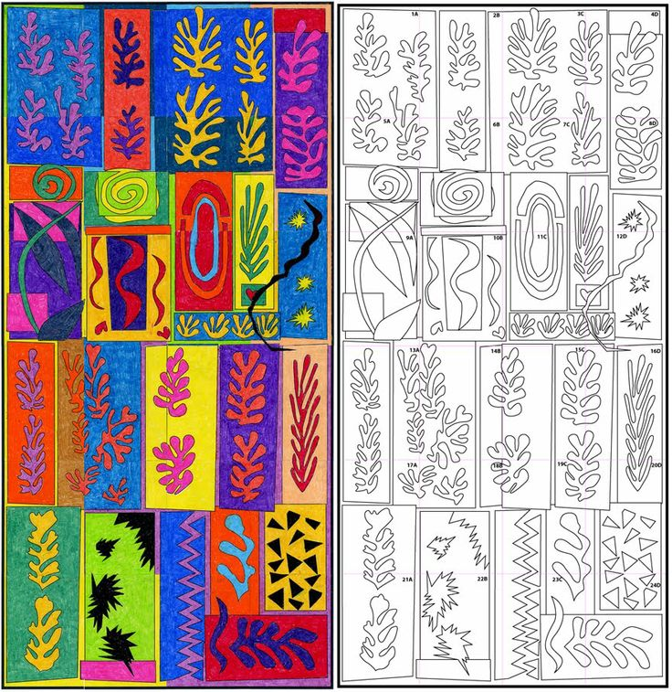
Samples of sea creatures or sea objects
Sea weed or sea kelp samples

Slide 12
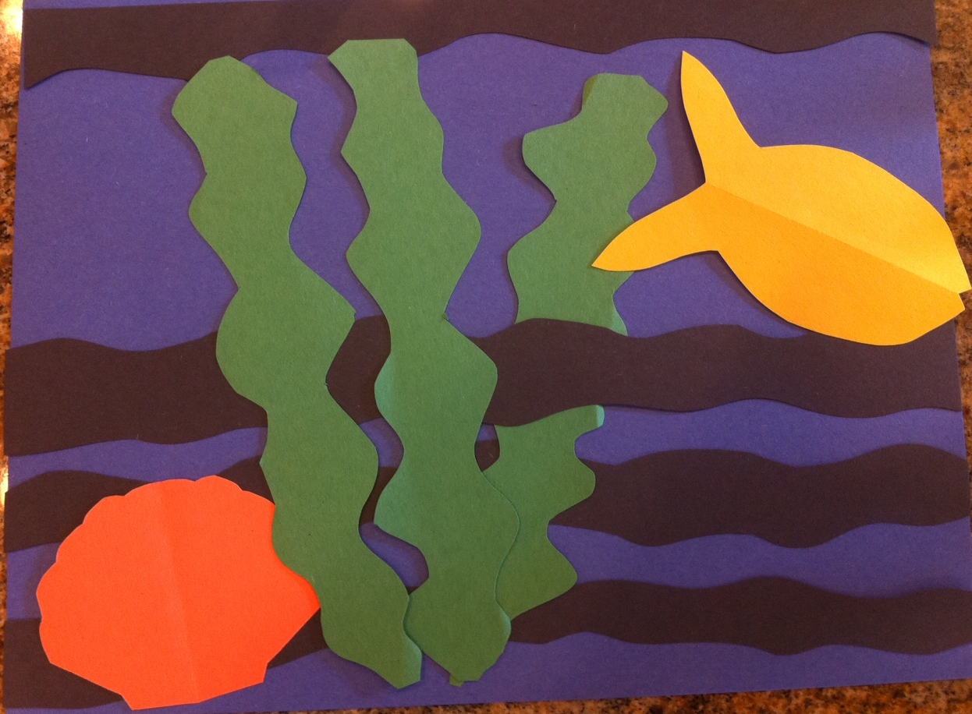
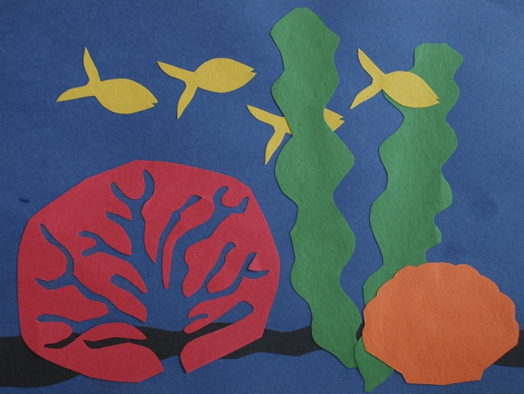
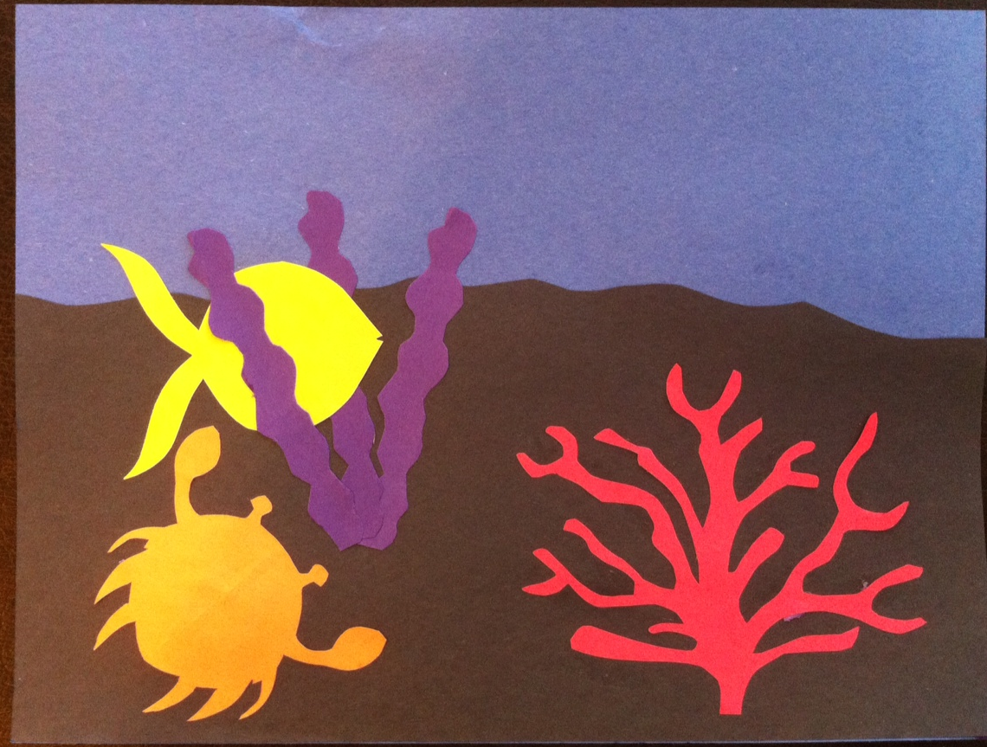
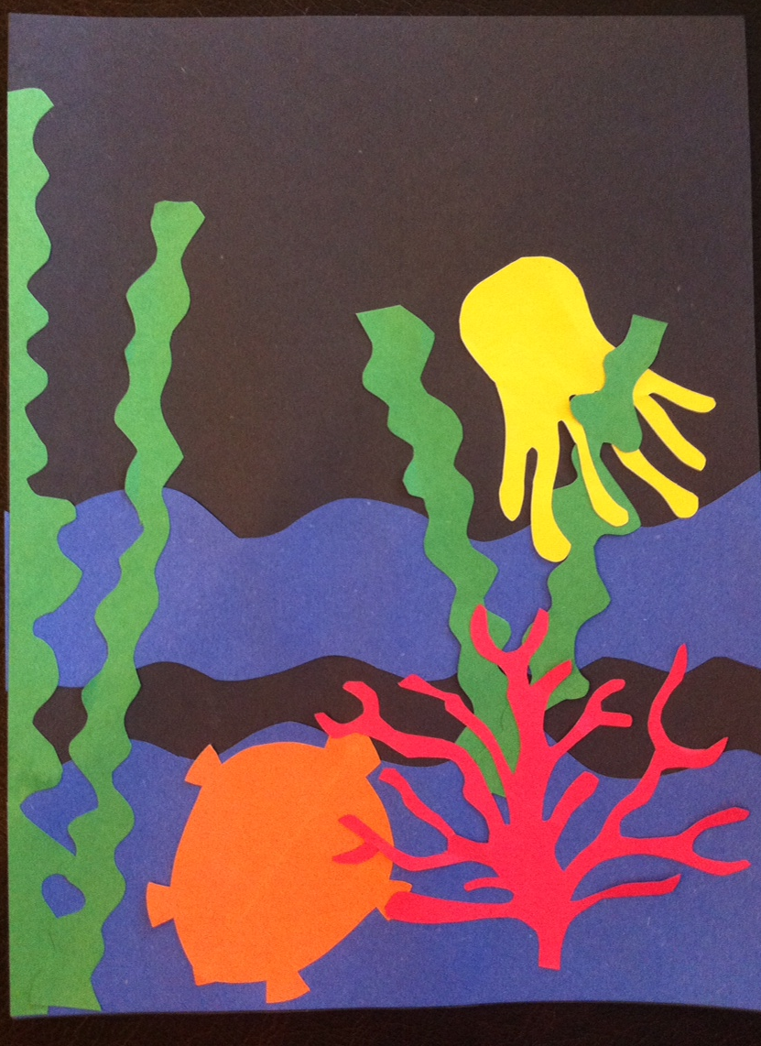
This sample uses the negative space from the coral cut out to create variety in your seascape.
This sample makes the ocean appear deep by using black on the ocean floor. This fish also appears to be behind the sea weed. This is called depth perception.
This sample shows how to create ocean waves.

