Slide 1
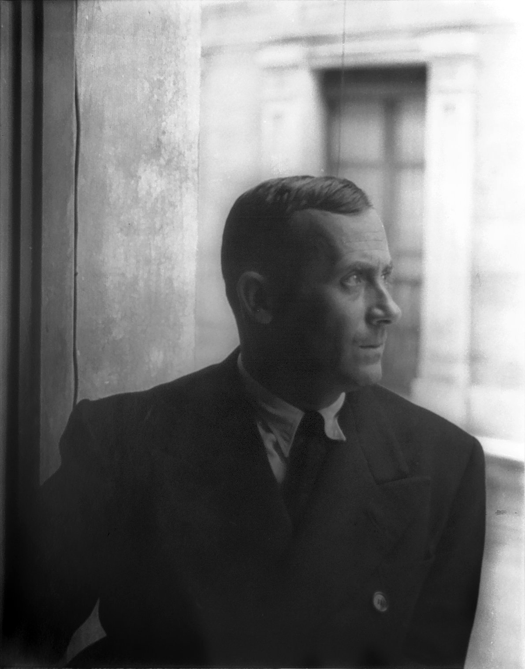
Joan Miro 1893-1983 Barcelona, Spain

Slide 2
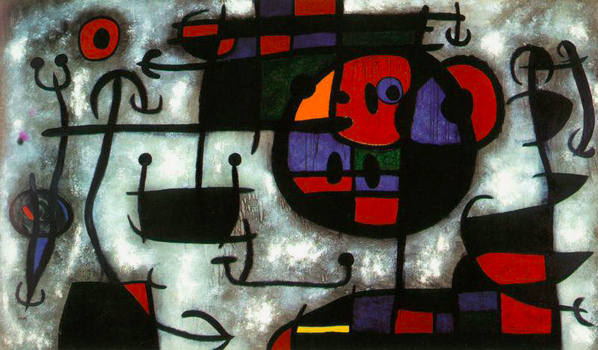
Joan Miro was a Spanish painter…

Slide 3
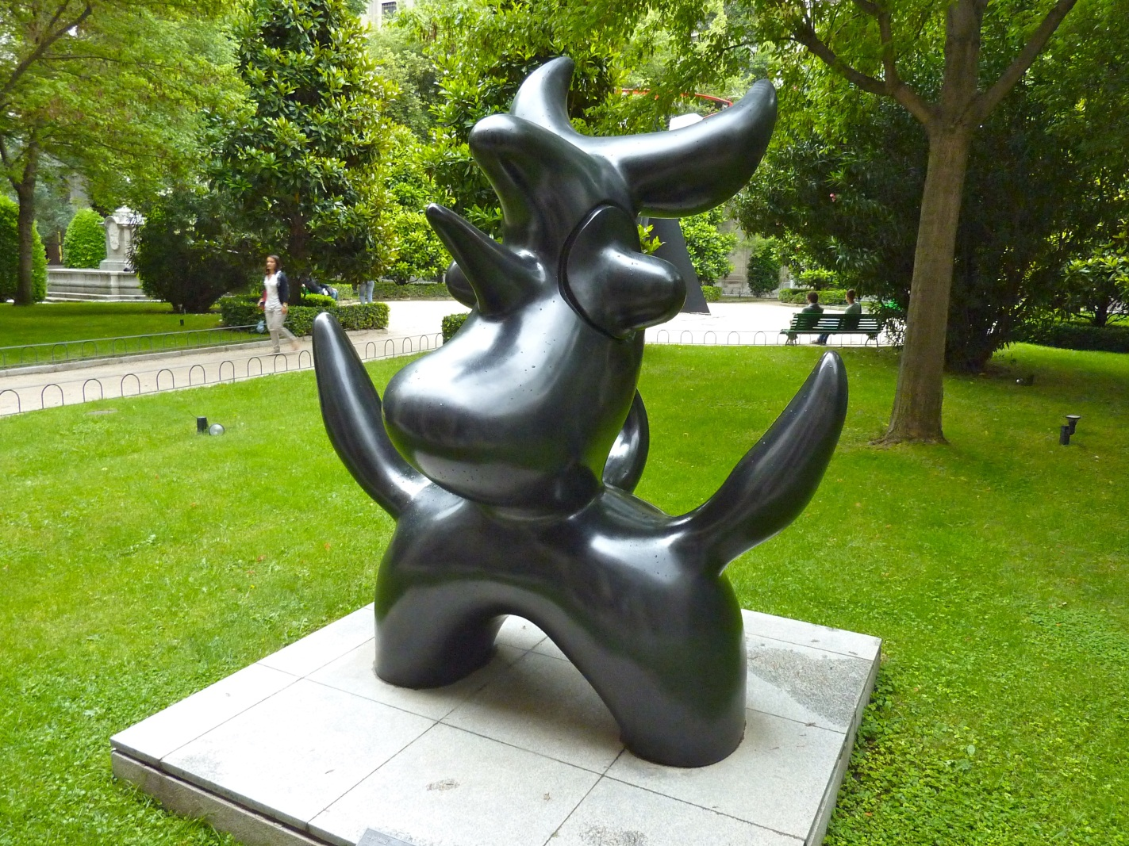
a sculptor

Slide 4
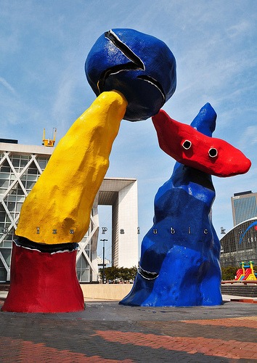
and ceramist.

Slide 5
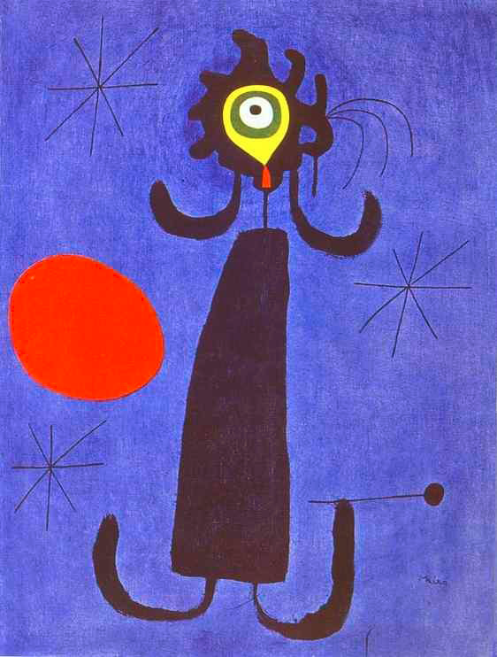
He was a Surrealist Artist.
Surrealist artists wanted to free their minds of rational thought.
Their paintings look like a dream; pairing a real-life creature in an unnatural state. (Such as in, “Woman in Front of Sun”.)
Some works just contained imaginary creatures.
“Woman in Front of Sun”

Slide 6
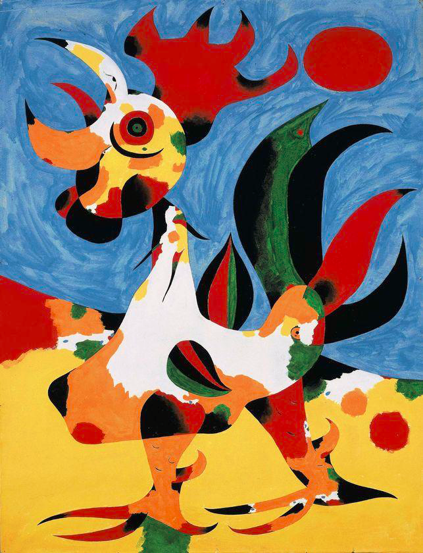
“Le Coq” (The Rooster)

Slide 7
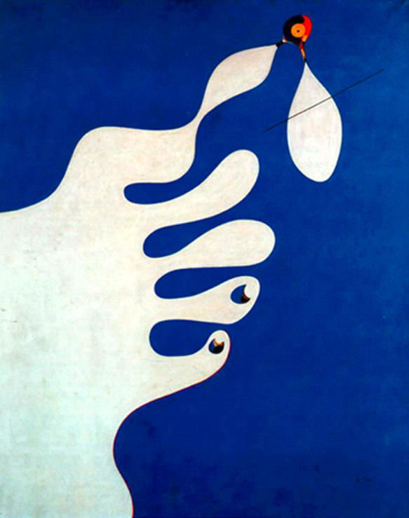
“Hand Catching a Bird”

Slide 8
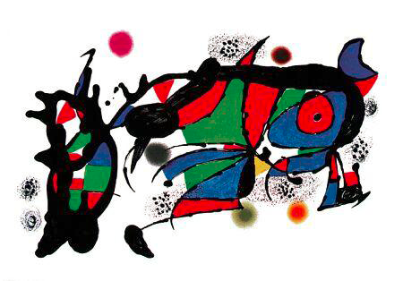
“Obra”

Slide 9
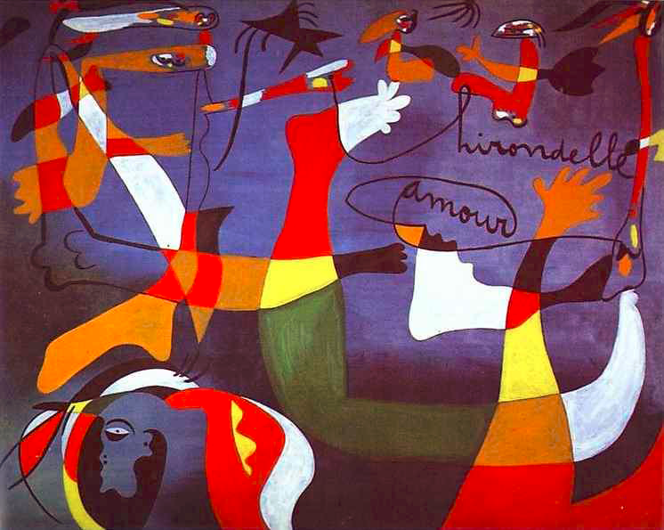
“Swallow Love”

Slide 10
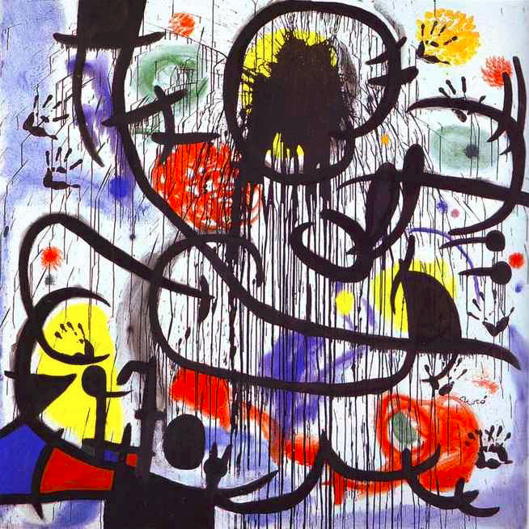
During his lifetime, Miro produced over 2,000 oil paintings, 500 sculptures, 400 ceramics, 5,000 collages/drawings and 3,500 lithographs and etchings.
“May 1964”

Slide 11
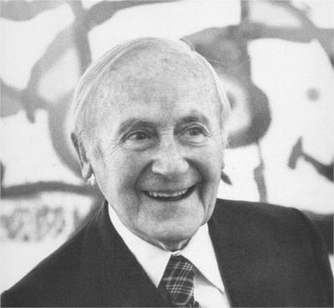
What is one thing that you learned today about Joan Miro?

Slide 12
Dreamlike Art (Surrealism)
Using a black sharpie, draw a line that loops and twists over your paper.
Look at your paper and see if you recognize, or imagine anything in your design.
You will add paint color to parts of the loops without covering the whole page in color.
Remember to add very little water to your paper and paints, only enough to make the colors deep and vibrant.

Slide 13
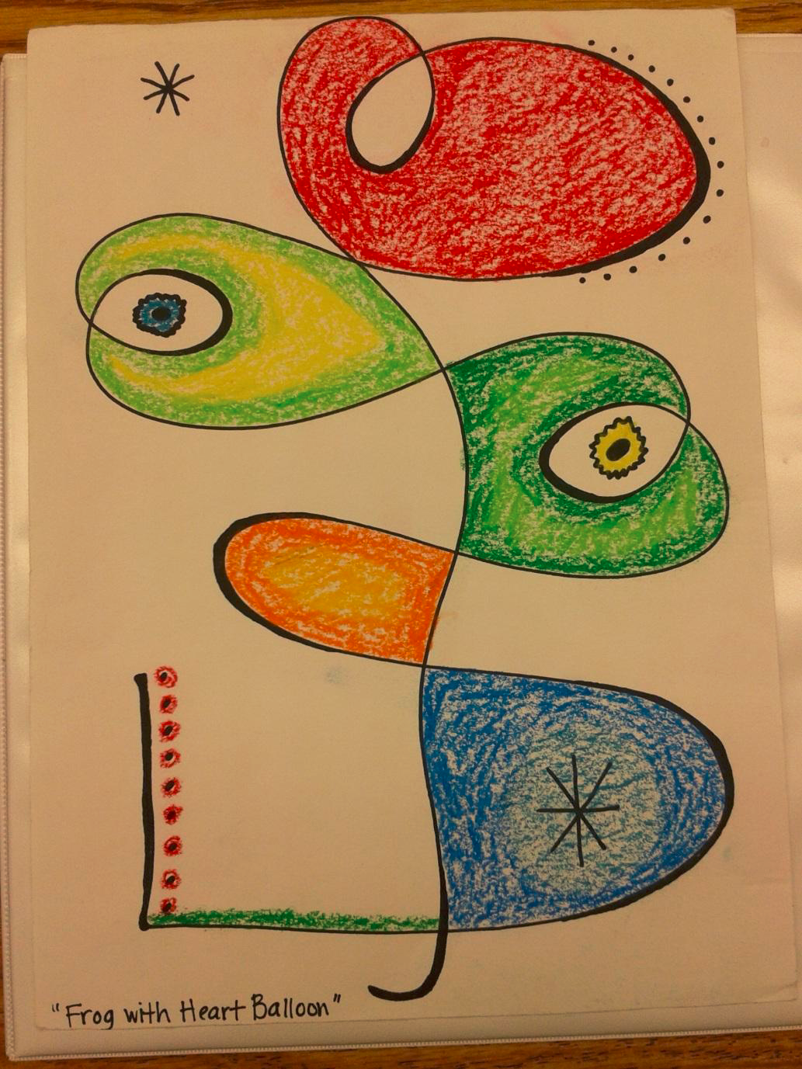
(Example using oil pastels instead of watercolor paints.)

Slide 14
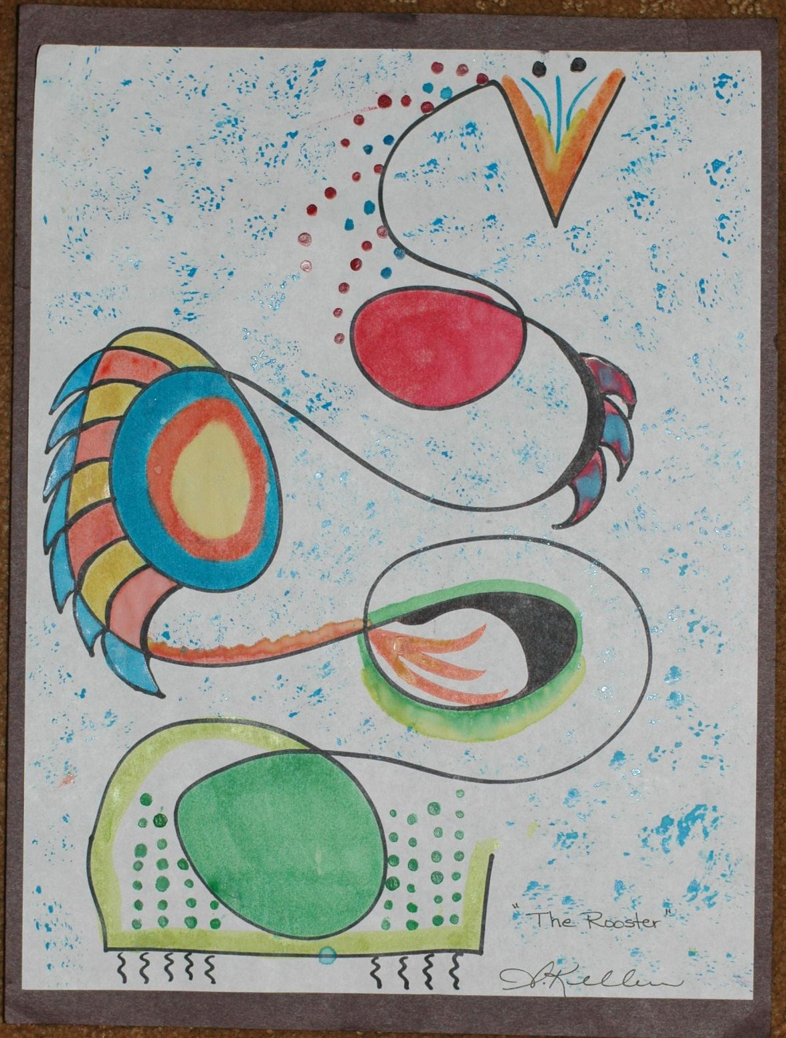
Example done in watercolors by an adult.

