Slide 1
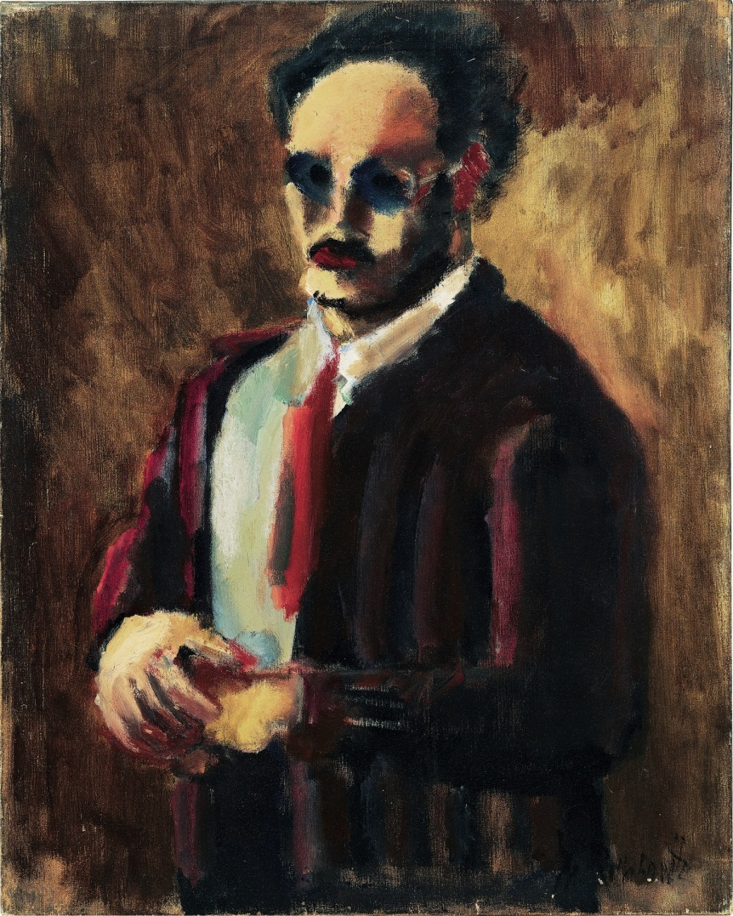
Mark Rothko 1903-1970
Born in Russia and moved to America when he was 10 years old.

Slide 2
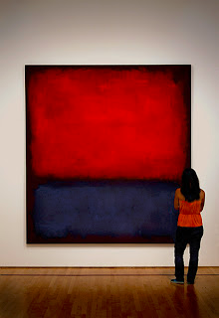
Rothko is an “Abstract Expressionist” artist.
Abstract art does not need to look like anything real.
It shows or creates emotion, feeling and ideas through color or shape.

Slide 3
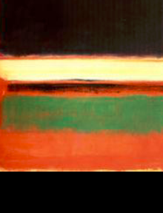
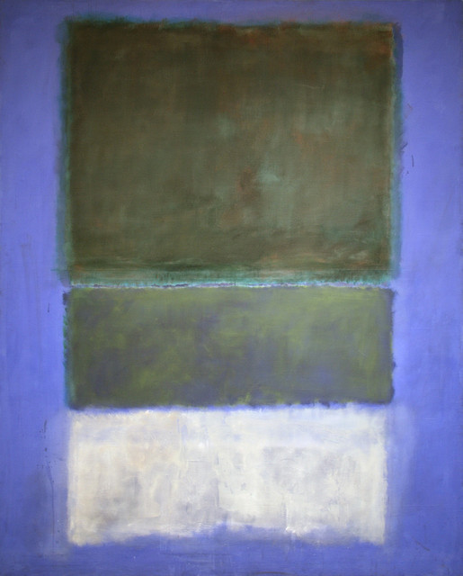
Rothko Multiform These have multiples of the same shape.

Slide 4
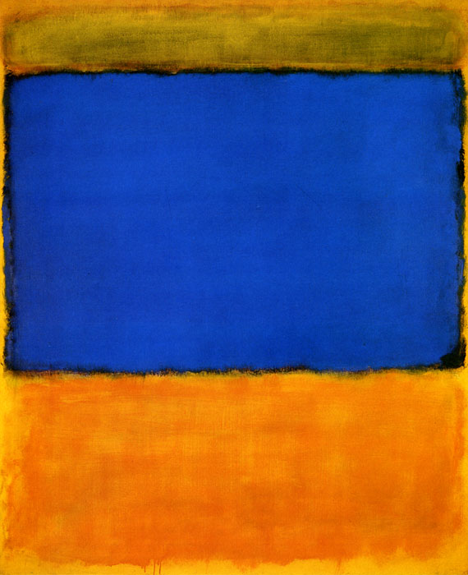
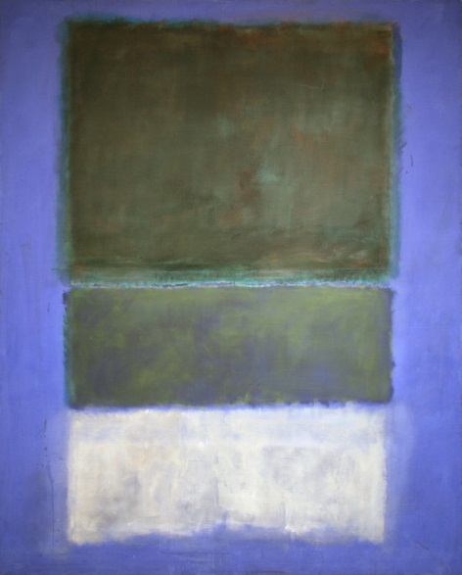
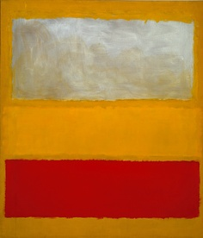
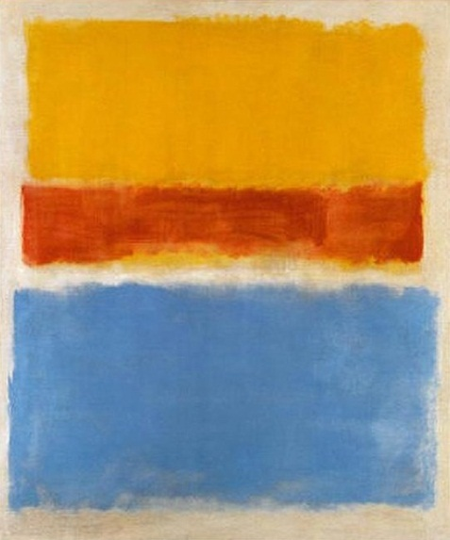
Paintings: Untitled 13
Which picture looks like a sunset?
Which picture looks like a thunderstorm?
How do these paintings make you feel?

Slide 5
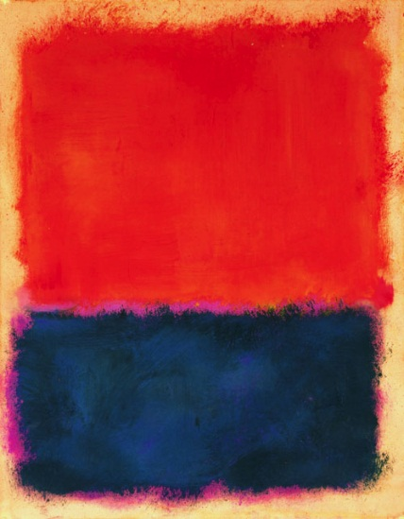
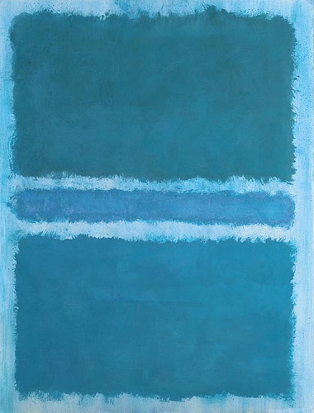
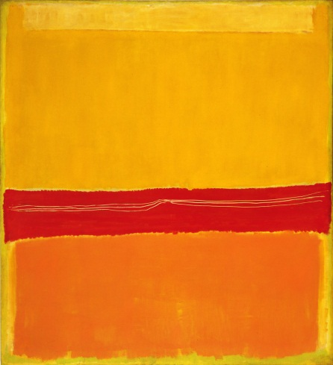
Some colors are “warm” and some colors are “cool”.
Warm colors are associated with fire, heat, sun, and warmer temperatures.
Yellow, red and orange
Cool colors are associated with water, sky, ice, and cool temperatures. –
Blue, green, and gray

Slide 6
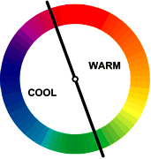
Color Wheel with warm and cool colors

Slide 7
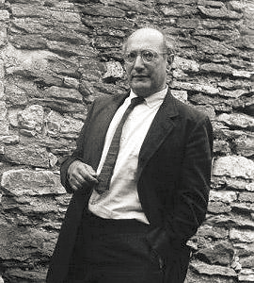
What is one thing that you learned about Mark Rothko today?

Slide 8
Making Abstract Art
Put on a paint shirt.
Put your name on the back of your paper.
Make two paintings: one using warm colors and one using cool colors.
Use the brush and paint a rectangle at the top of your paper.
Paint another small, thin rectangle.
Paint a third rectangle on the bottom.

Slide 9
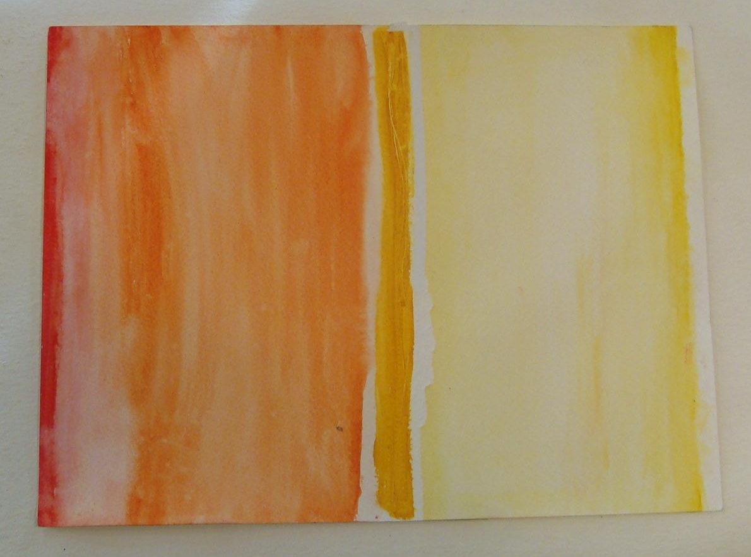
Warm Color Sample

Slide 10
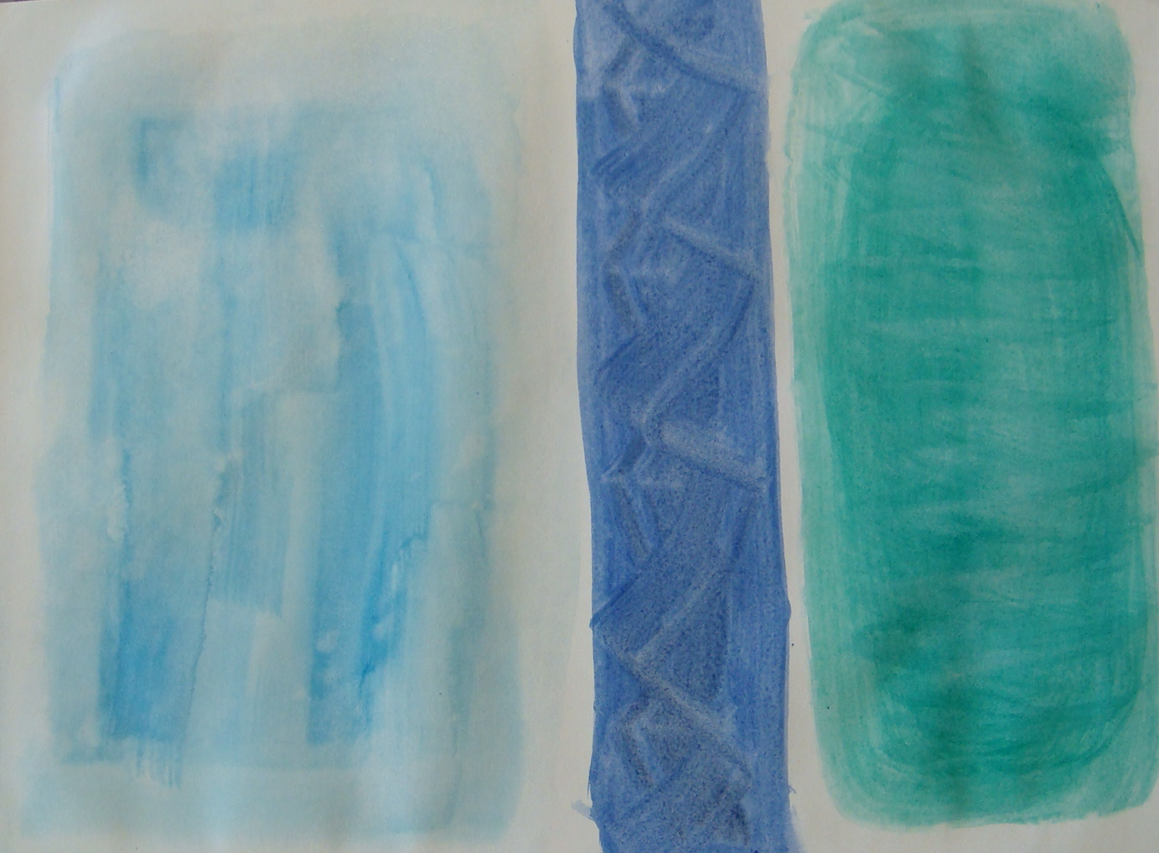
Cool Color Sample

