Slide 1
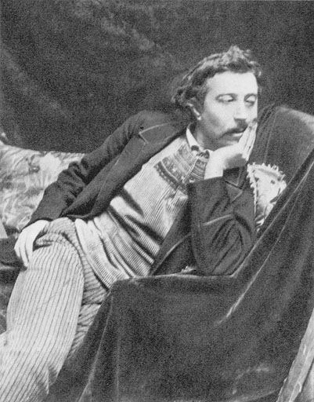
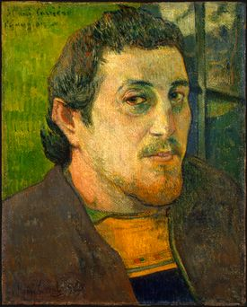
Paul Gauguin (GO-GAN) 1848-1903 Born in Paris, France
Self Portrait

Slide 2
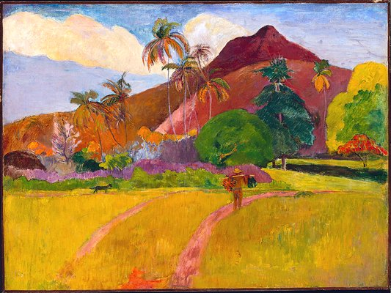
Paul Gauguin was a leading French Post Impressionist painter, sculptor, print maker, ceramist and writer.

Slide 3
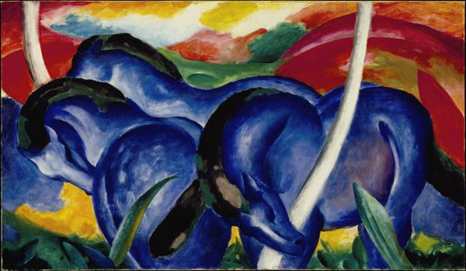
Post Impressionism is a way of using vivid colors, thick application of paint, distinctive brush strokes, and real-life subject matter, but emphasizes simple geometric shapes, distorts form for expressive effect, and uses unnatural color.
For example, what color are these horses? Are mountains usually red? Is there a lot of detail in the picture?
“Large Blue Horses”

Slide 4
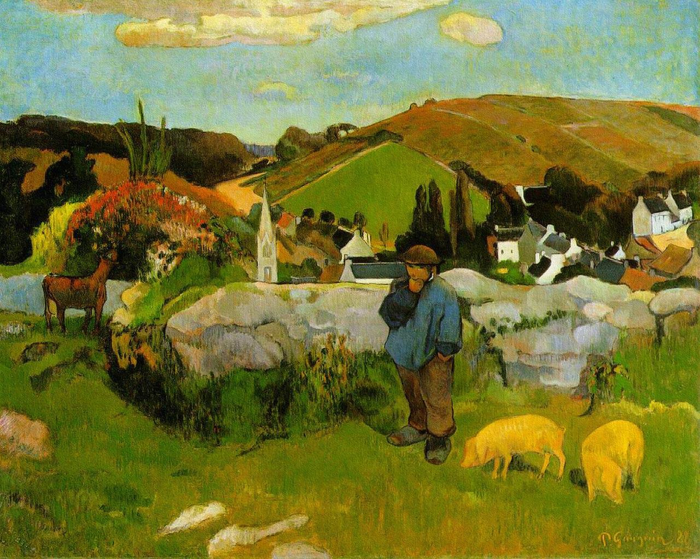
“The Swineherd”
Gauguin travelled quite a bit in his early life.
He lived in Peru as a child and became a sailor as a teenager.
His many travels and adventures instilled an imagination in him that would later be evident in his art.

Slide 5
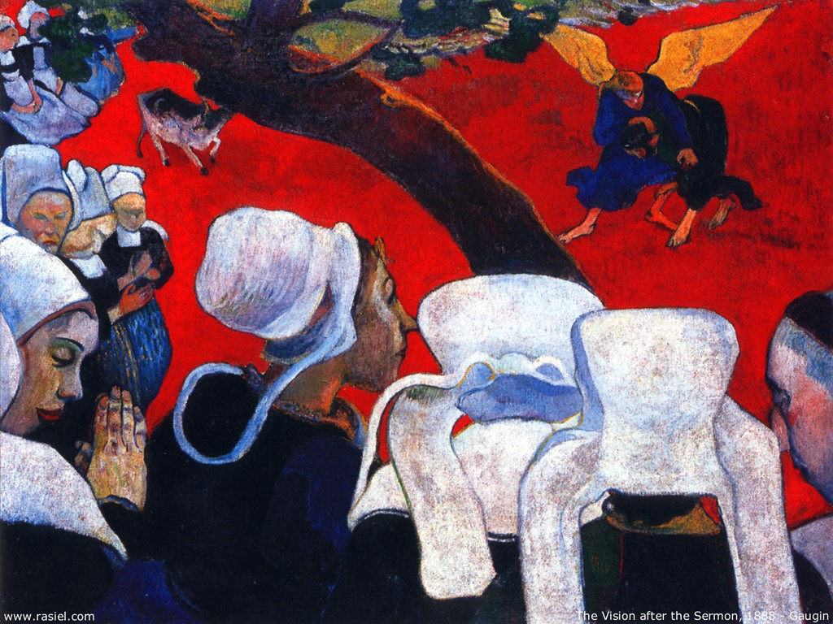
Gauguin did not become an artist until later in his life, leaving a successful career as a stockbroker.
“The Vision After the Sermon”

Slide 6
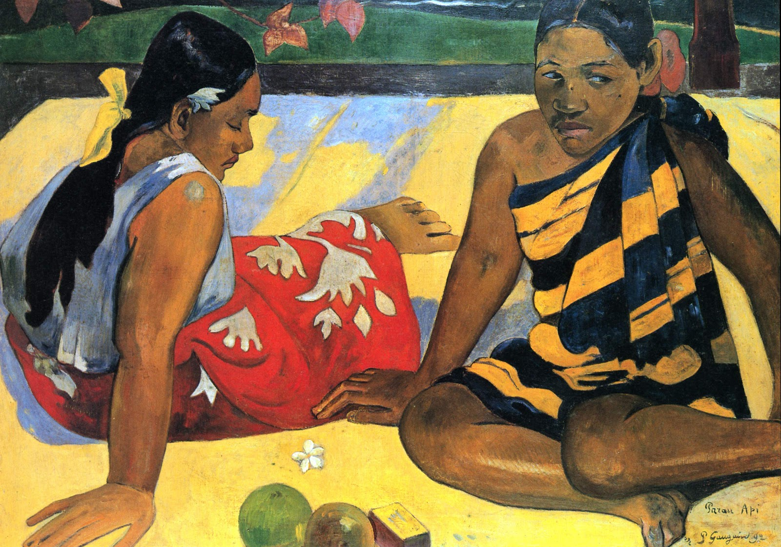
Gauguin went to Tahiti to paint and never left.

Slide 7
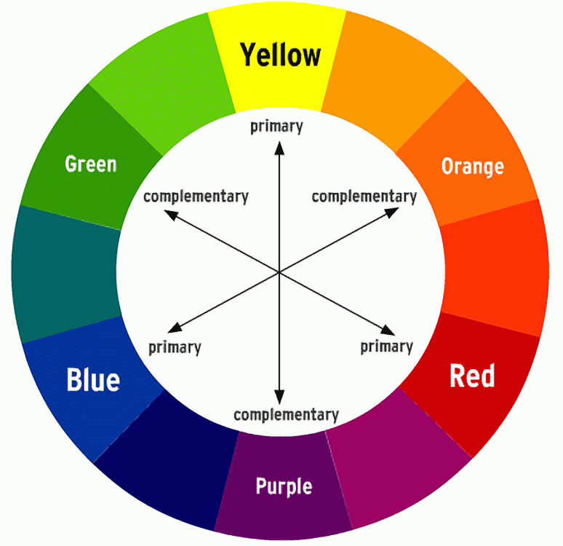
Gauguin used complimentary colors to make his artwork seem more vibrant and intense.
Complimentary colors are opposite one another on the color wheel.
If you look at the color wheel to the left, you see that a primary color is complemented or enhanced by its opposite secondary color such as blue and orange.

Slide 8
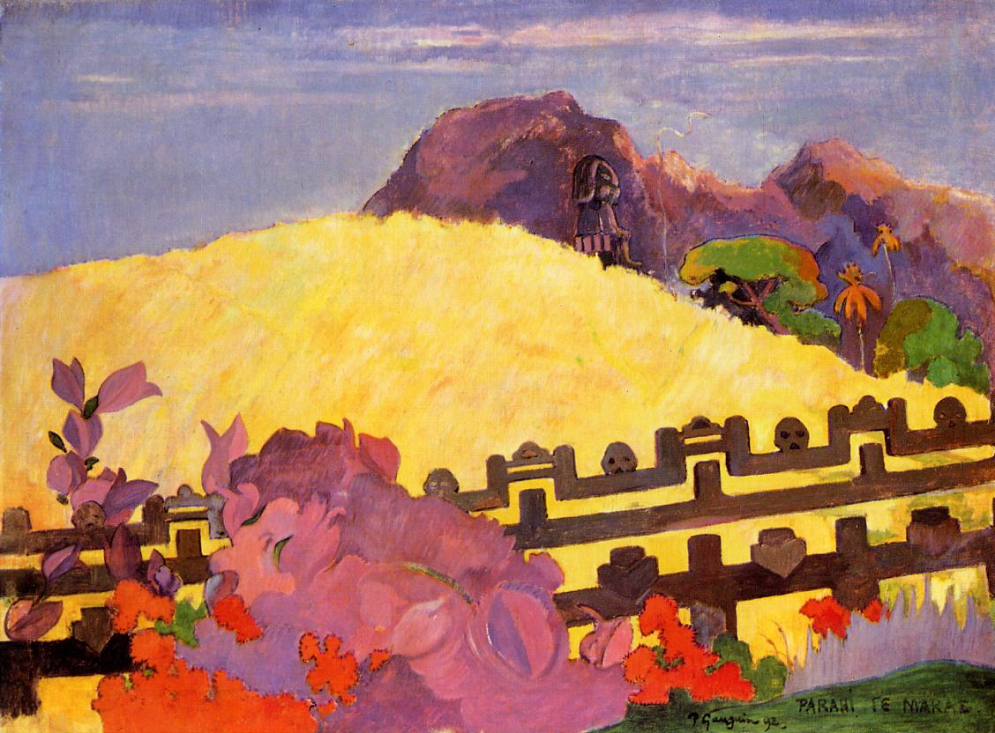
In the painting, “The Sacred Mountain”, Gauguin used complementary colors like yellow/purple and red/green to make the colors more vibrant because they “complement” each other.
“The Sacred Mountain”

Slide 9
Gauguin also used perspective in his paintings.
Notice how the items at the bottom of the painting (foreground) are larger and have more detail while the objects at the top of the painting (background) are smaller with less detail.
Also notice the curved horizontal line that separates the sky from the earth. This is called the horizontal line.
All of these elements give depth and perspective to his painting.

Slide 10
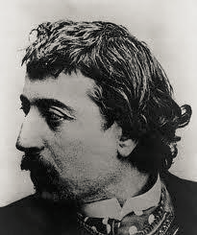
What is one thing that you learned today about Paul Gauguin?

Slide 11
Complementary Colors Landscape
Put on a paint shirt.
Put your name on the back of your paper.
Using masking tape, tape your paper down on all sides making a “frame” around your future painting.
On a separate piece of paper, sketch your ideas first, including mountains, hills, lakes, rivers, clouds, trees, bushes or whatever you choose. Remember to make the items in the background smaller and those in the foreground bigger with more detail.
Think about your horizon line, where sky meets the earth, traveling across your paper. This could be a hill, mountain range or the flat line of water.
When satisfied with your drawing, redraw on your taped down piece of paper.
Think about the normal colors of your landscape and choose their opposite, complimentary colors to use in most of your painting. (Look at the color wheel if needed)
Be sure to rinse your brushes in between colors.

Slide 12
