Slide 1
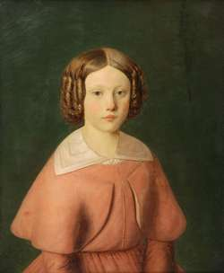
Rosa Bonheur (BAHN-ER) 1822-1899 Born in Bordeaux, France

Slide 2
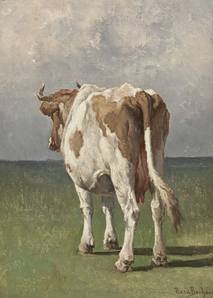
Rosa Bonheur’s father was an artist and her mother a music teacher.
Her father gave her and her siblings art lessons. They all became artists.
Her family kept some small barnyard animals on their semi-rural property outside of Paris.
According to family records, Rosa had trouble learning to read, so her mother helped her learn by drawing an animal for every letter of the alphabet.
“Study of a Cow”

Slide 3
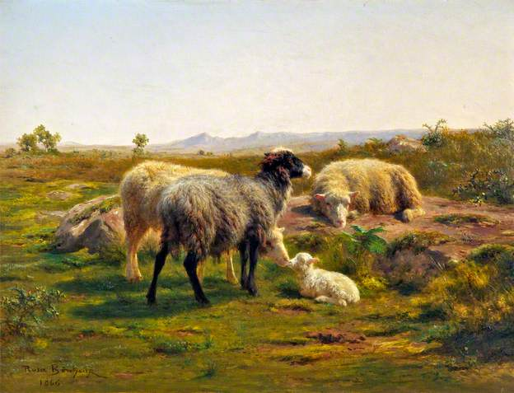
“Sheep and a Lamb”
Rosa gained a love of drawing animals through her alphabet studies.
She became a “realist” artist. Realist artists attempted to draw things accurately according to what they saw or felt.
She became known as one of the most faithful “animalieres” (painter of animals) and even sculpted animals in bronze.

Slide 4
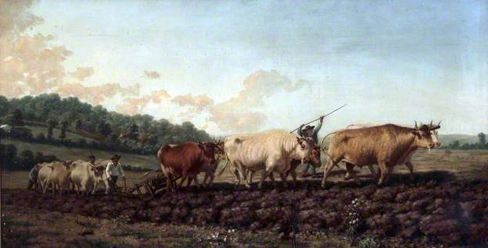
Rosa gained instant popularity after she completed her commissioned painting, “Ploughing in the Nivernais”, in 1849 (below).

Slide 5
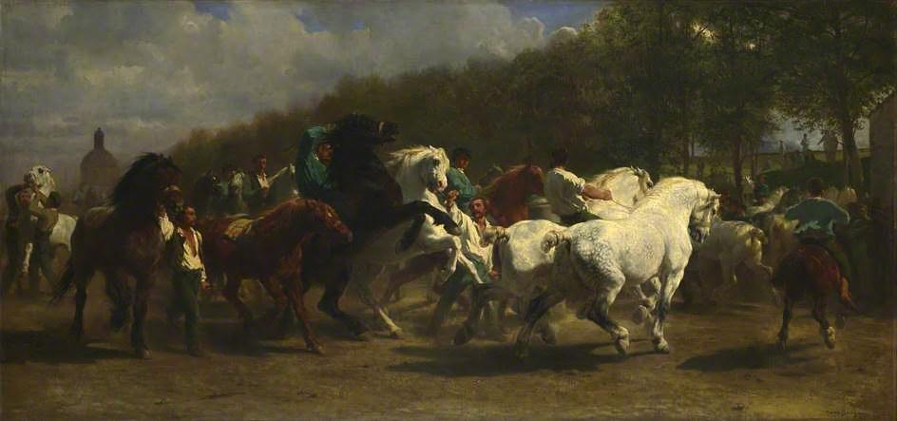
Her most famous work was “Horse Fair”, (above) completed in 1855, which measured eight feet high by sixteen feet wide.

Slide 6
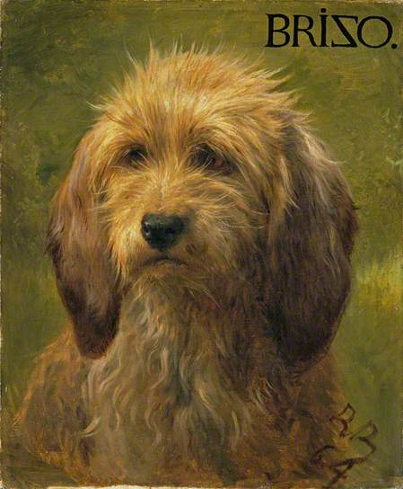
Part of Rosa Bonheur’s legacy is her contribution to helping female artist have more equality with male artists.
Women were not seen wearing men’s clothing such as overalls, but Rosa got special permission to wear them because they were more practical for being around animals.
She also received honors that had previously only been awarded to men.
“Brizo, A Shepherd’s Dog”

Slide 7
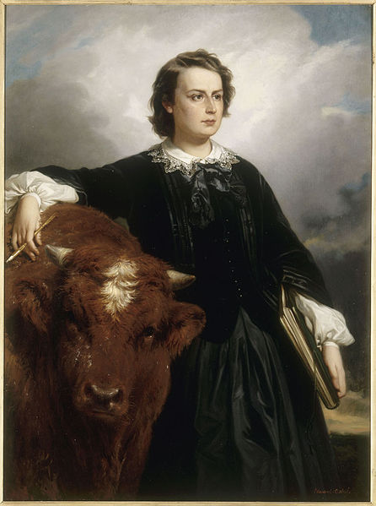
What is one thing that you learned today about Rosa Bonheur?
Portrait of Rosa Bonheur, 1857.

Slide 8
How to Draw a Cat (Using symmetry and shading)
Fold your paper (with the left side of a cat’s face) in half twice making four boxes.
Draw the right side of your cat’s face.
Take your time. Notice the four boxes and what part of the cat’s face is in which box. Notice the face shape.
Add texture (fur) and shading to your cat using either pencil or different colors of colored pencils.
If you choose colored pencils, make sure to use a light and dark tone of a color to show the light and dark spots on the cat’s face. Leave a few spots white to highlight the cat’s face.
Draw your texture lines (cat fur) radiating away from the face, just like real cat’s fur. These kind of lines are called hatch marks; parallel lines drawn closely together to show texture and shading.
Shade the dark areas of the face last, colored heavily with a standard pencil/colored pencil to make the darkest gray or color tone possible.
Example from artprojectsforkids.org

Slide 9
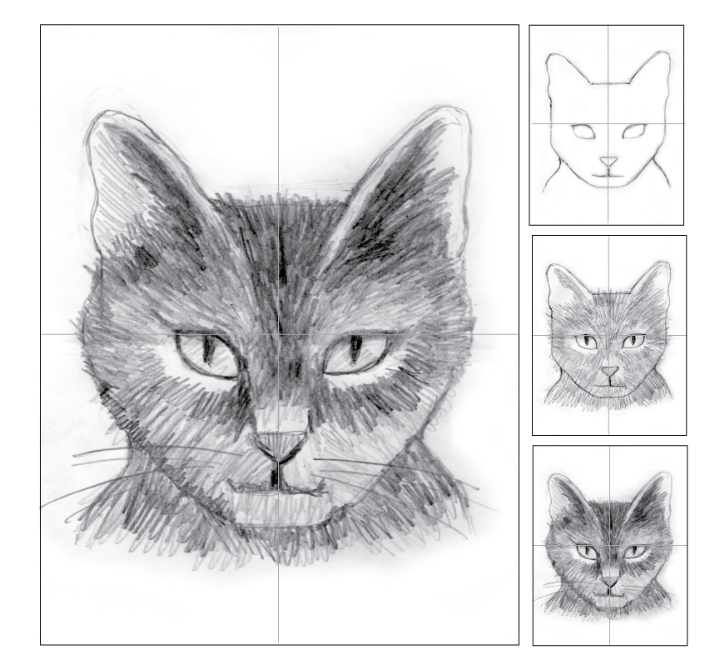
Example from artprojectsforkids.org

Slide 10
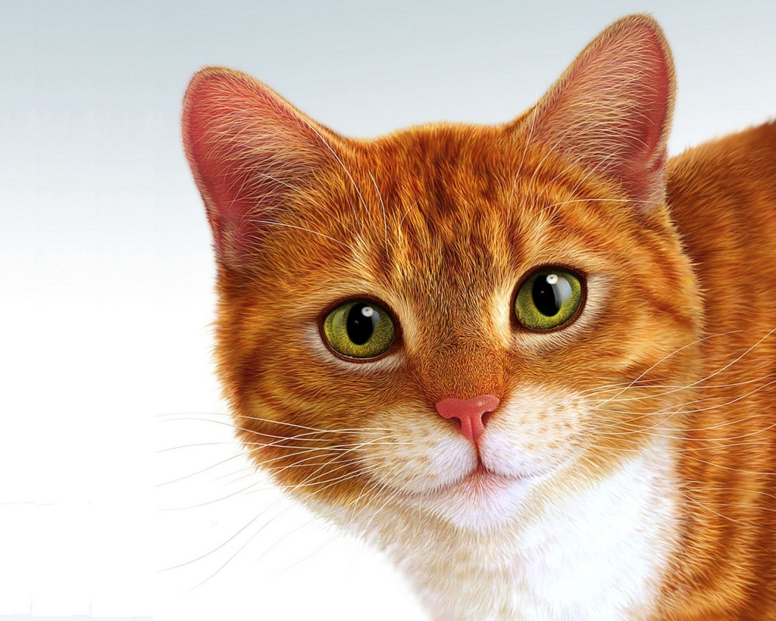
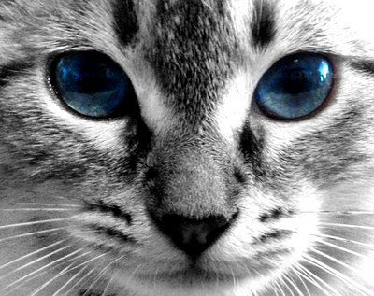
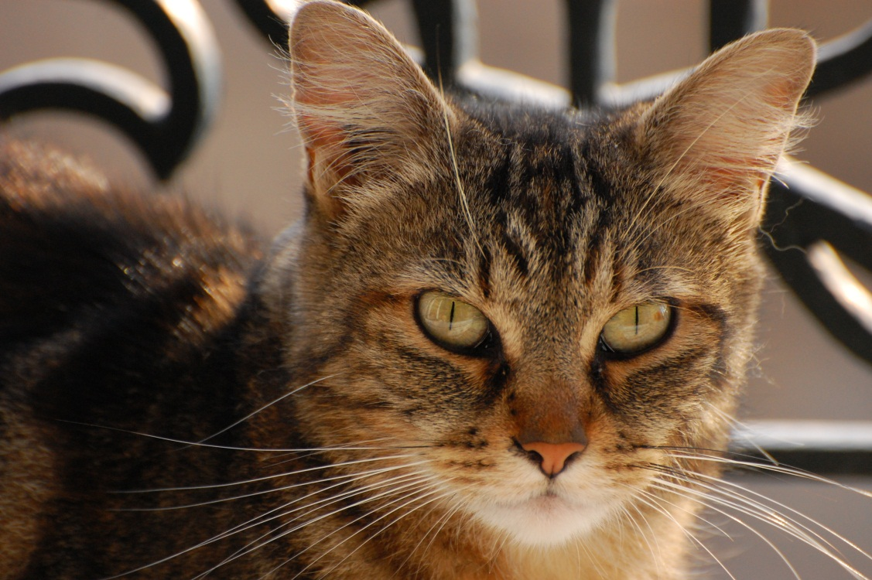
*Sample coloring of cats. Notice where the darker colors are and the lighter colors. White or a lighter color often goes around the eyes to highlight the eyes.

