Slide 1
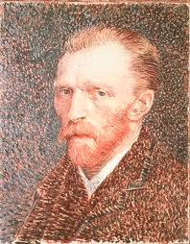
Vincent Van Gogh 1853-1890 Born in Zundert, Netherlands

Slide 2
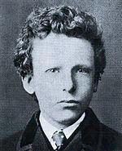
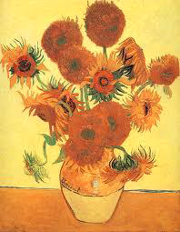
Van Gogh was born and raised as a child in the Netherlands to a minister of the Dutch Church.
As a child, Vincent was serious, silent and thoughtful.
Van Gogh did not begin painting until his late twenties.
Most of his best-known works were produced during his final two years.

Slide 3
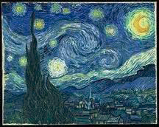
Van Gogh was a Post Impressionist painter.
Post Impressionist means that his paintings came after the influences of impressionism (or impressions of subjects).
“Starry Night”

Slide 4
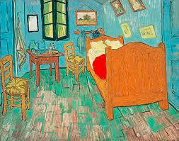
“The Bedroom”

Slide 5
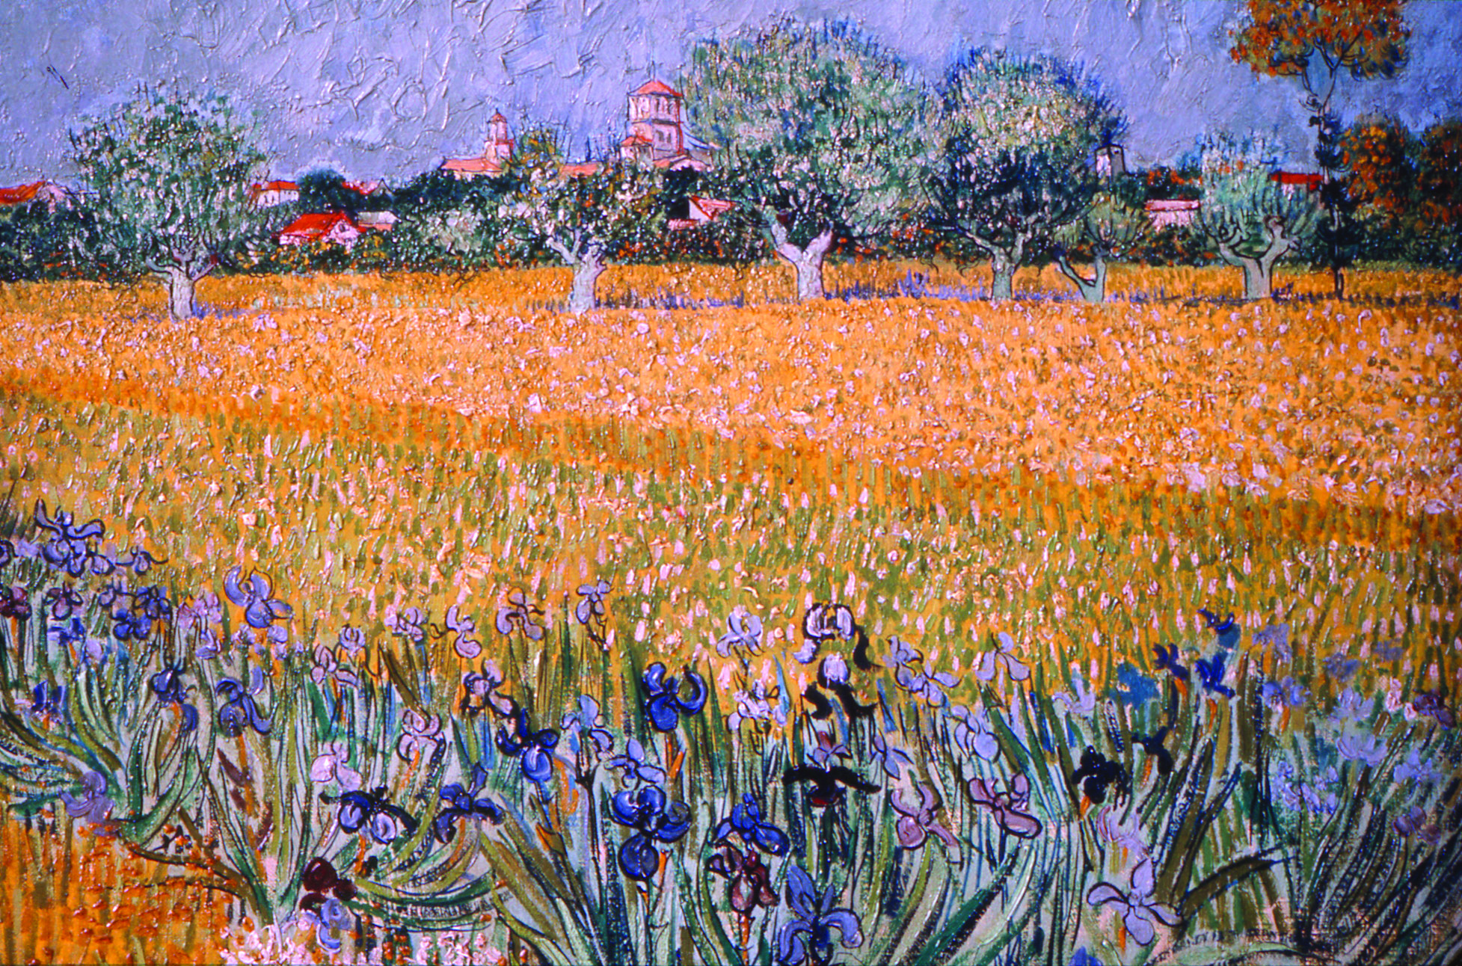
“Field with Flowers Near Arles”, 1888.

Slide 6
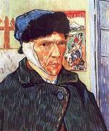
This is a self portrait of Van Gogh after he had become very ill.
He was never quite the same and become more popular as an artist after his death at the age of 37.

Slide 7
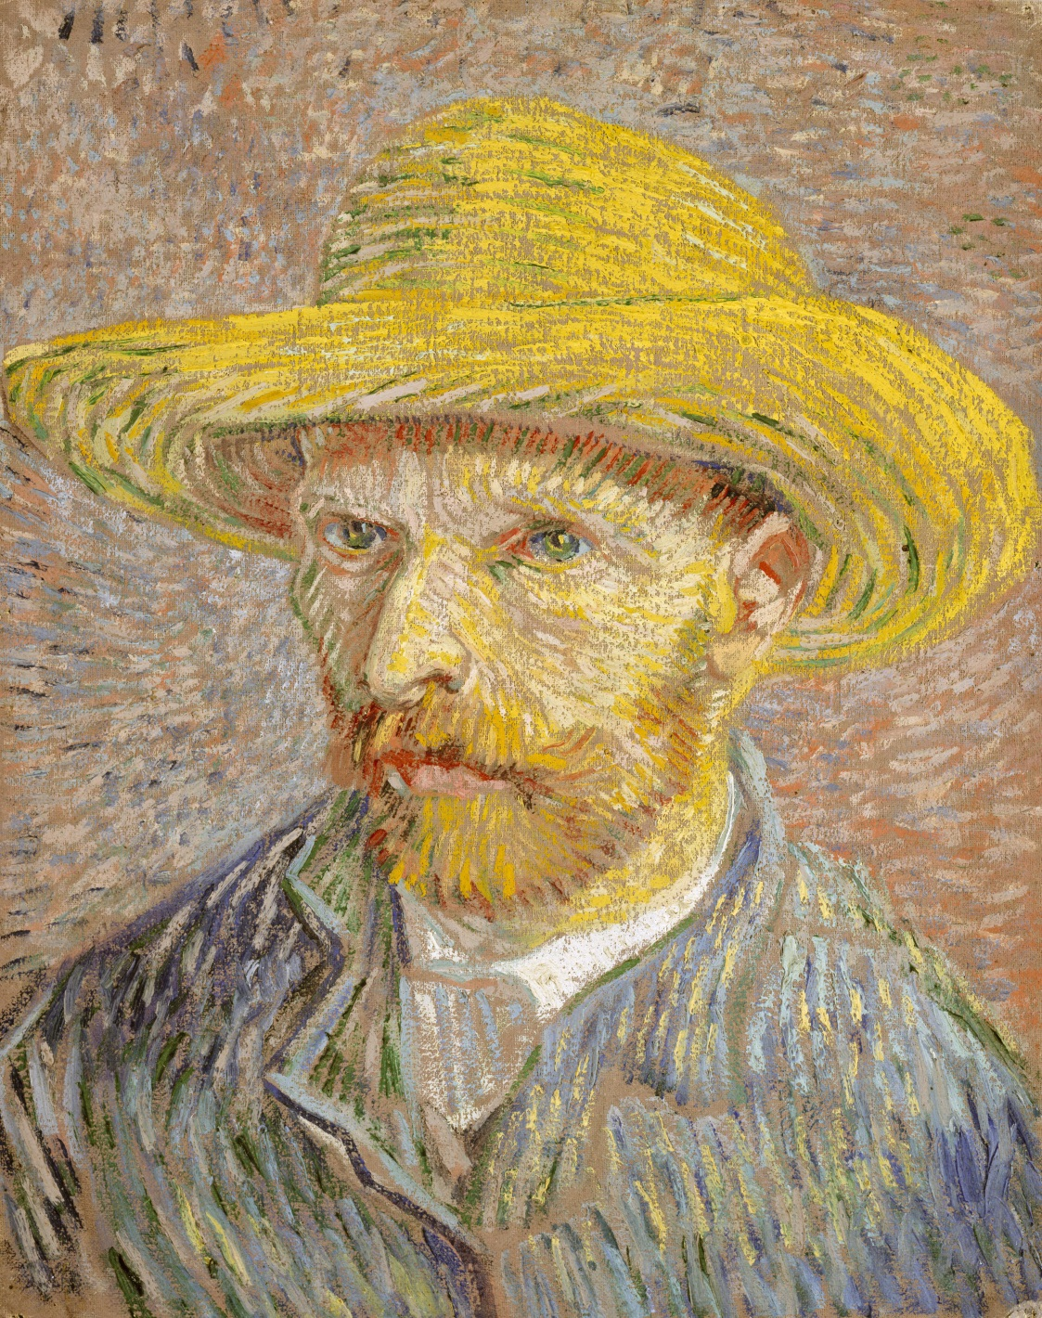
What is one thing that you learned today about Vincent Van Gogh?
“Self Portrait with Straw Hat”

Slide 8
Sunflower Fields on a Sunny Day
Start with a piece of light blue construction paper. In the horizontal position draw a line one third the way across the paper. This is the horizon line.
Using a yellow oil pastel draw small circles all over the bottom portion of the paper. This will begin the field of sunflowers. Next, add orange oil pastel in circular motions to the yellow sunflowers just made. The orange will help give the flowers dimension. Finish up each flower by adding a brown center with a brown oil pastel.
Create the sun by starting with a large yellow circle in the top right corner of the page. Add orange using circular motions. Heavier orange on the outer part of the sun and more yellow toward the center of the sun.
Using different shades of blue oil pastels if available create swirls that fill the sky. Finish with some white swirls in the sky.
Content from: teachkidsartappreciation.com

Slide 9
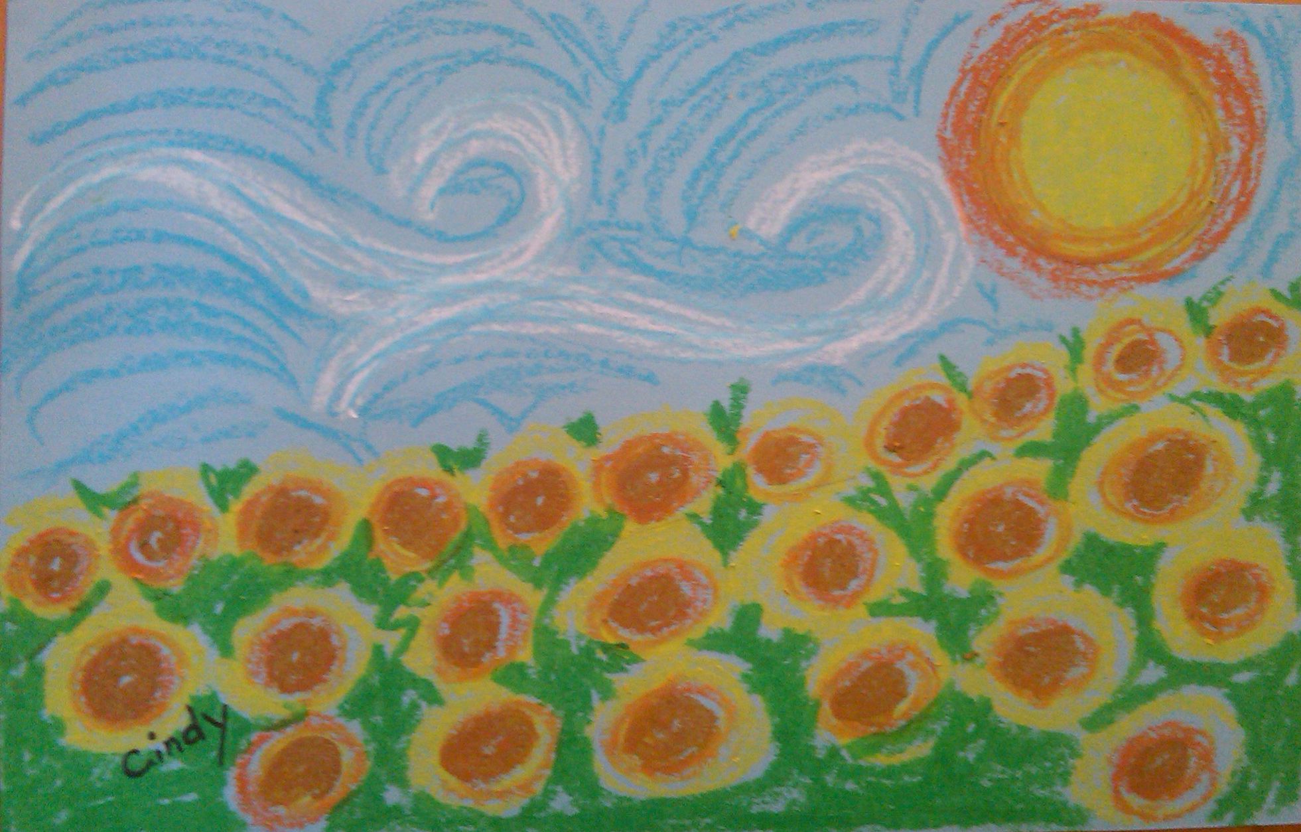

Slide 10
Alternate Project: Sunflowers in a Vase
Have the children assemble their table placement and the vase using rubber cement to place them permanently down. Using their pencil, the children should decide where they want to place three flowers around the page. Advise them to space the flowers out around the page so they are not all in a row or right next to each other. The space around them will be filled in.
Using a brown crayon, fill in the center of each flower by pressing firmly with the crayon. This is the center of the sunflowers.
In these examples the children used a plastic fork to make “x” marks all around the center of the flower.
Using their thumb or index finger, dip the finger in yellow paint and dap around every flower, reloading paint onto the finger as needed. Do the same thing with the orange paint.
By dipping their finger in green paint and either white or a pre-mixed lighter green paint at the same time they can dab “leaves” all around and empty spots. Fill in any center area with the green leaves.
With any time remaining children can use crayons to decorate the vase, table and background.
Content: teachkidsartappreciation.com

Slide 11
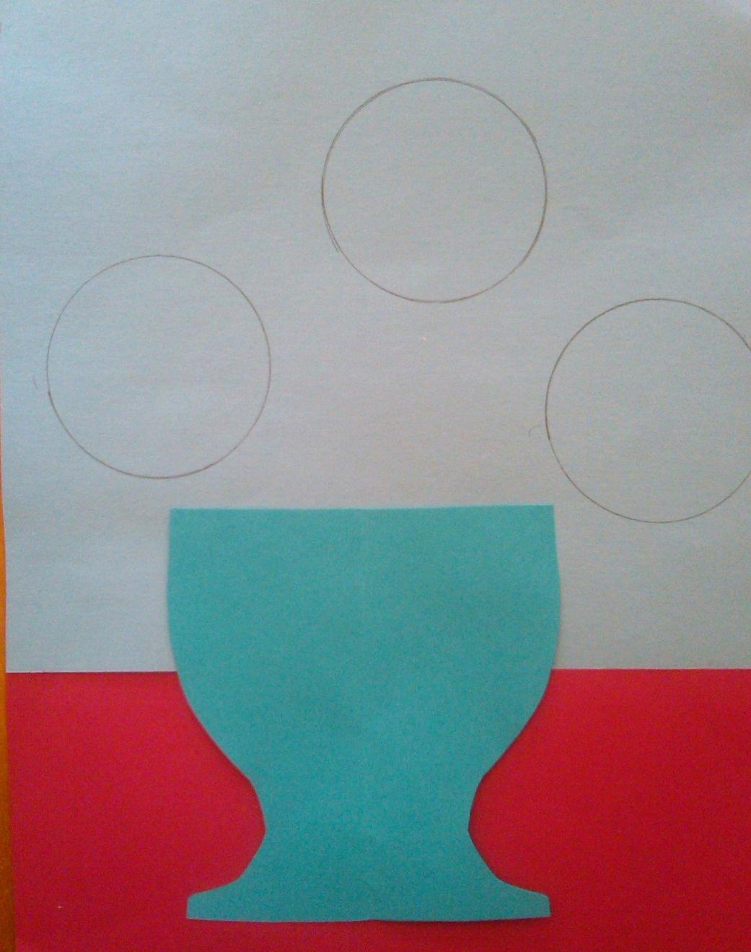
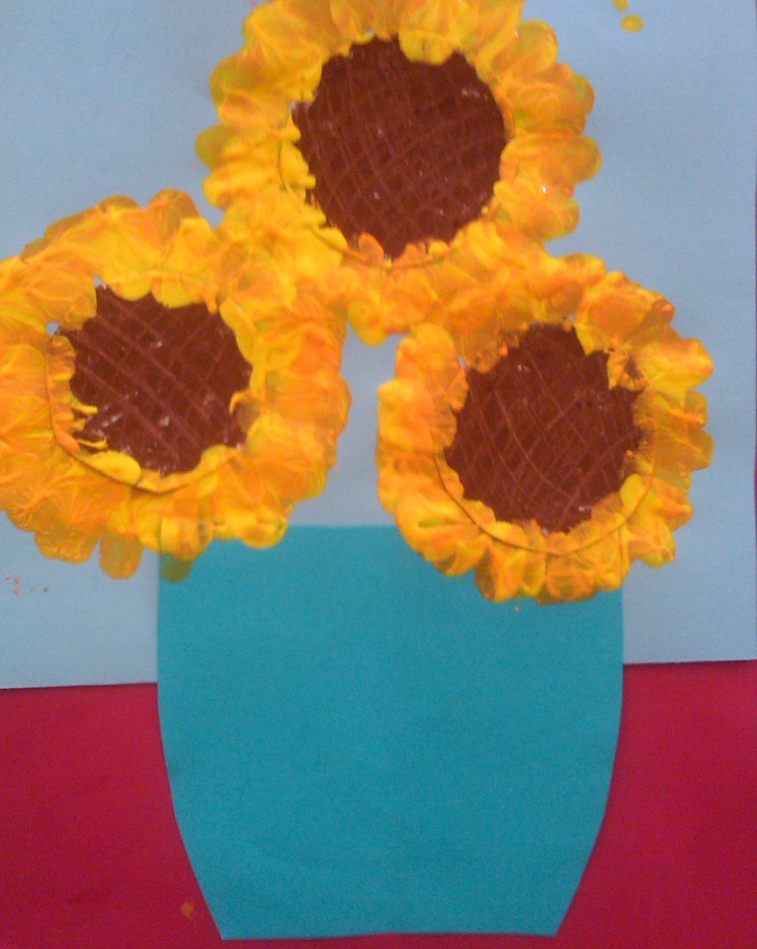

Slide 12
