Slide 1
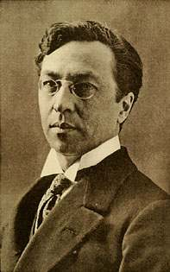
Wassily Kandinsky 1866-1944 Born in Moscow, Russia Died in France

Slide 2
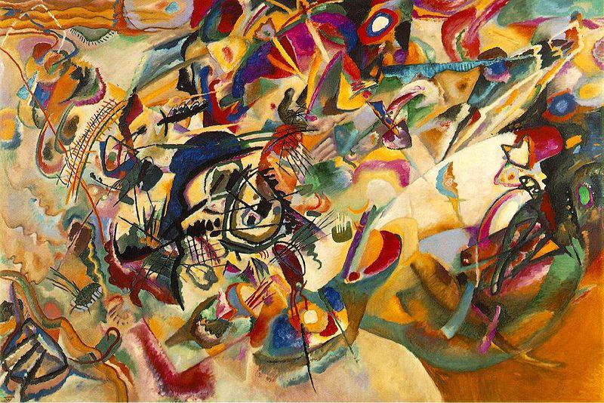
Wassily Kandinsky took music and art lessons as a child in Russia, but did not become a professional artist until he was 30 years old.
He gave up his job as a law professor and moved to Germany to study art.

Slide 3
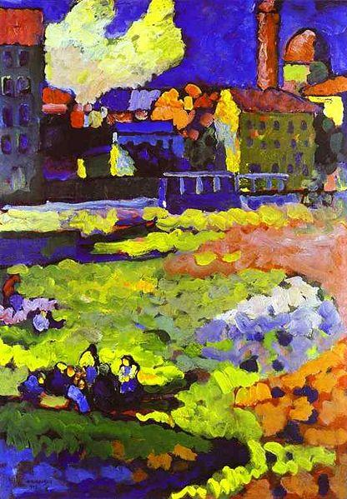
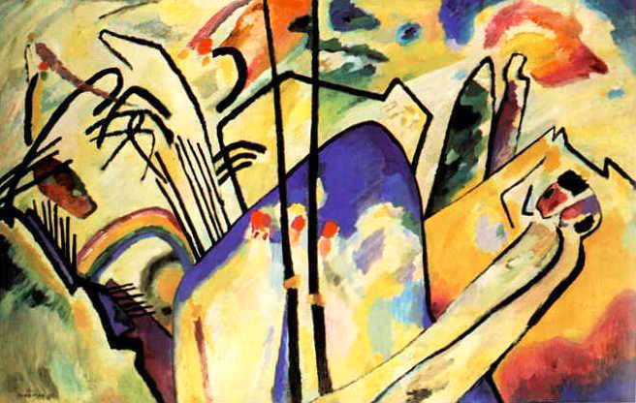
The impressionist painters started painting pictures at that time that didn't look exactly real.
Kandinsky was the first artist to take the final step away from realism.
He painted the first totally abstract pictures; paintings that were pure designs, and believed that colors and forms had meaning all their own.
Kandinsky early-period work. “Munich-Schwabing with the Church of St. Ursula” (1908).
“Composition V”, 1911

Slide 4
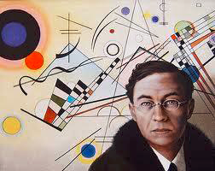
He was a musician as well as a painter, and thought of colors as music.
Simple pictures were like melodies, complex paintings were symphonies.
He called many of his paintings “improvisations”, meaning a song made up on the spot, not planned ahead of time.

Slide 5
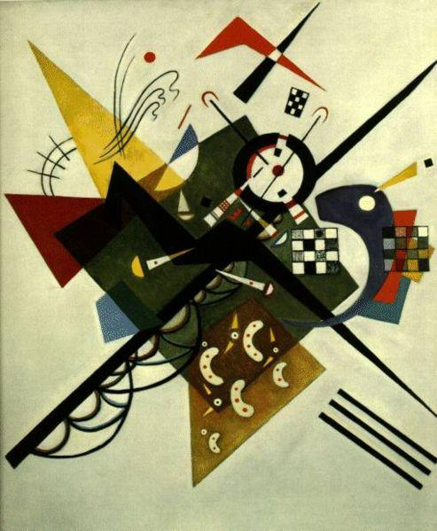
Geometric elements (shapes, curves and lines) were important in Kandinsky’s painting.
What shapes do you see in this painting?
His paintings were rich in colors with different shades of red, yellow and blue.
“On White II”, 1923

Slide 6
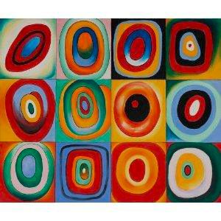
“Farbstudie”

Slide 7
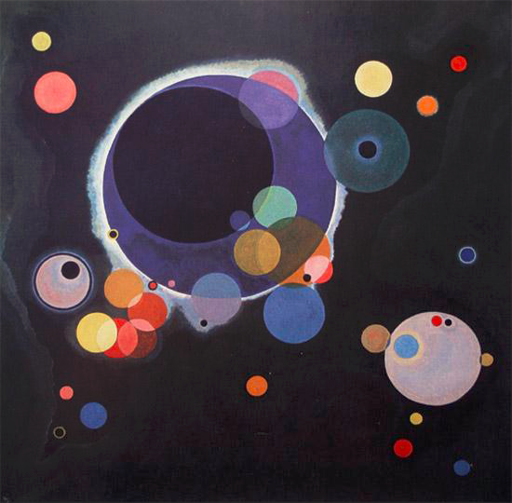
“Circles in Circles”, 1926

Slide 8
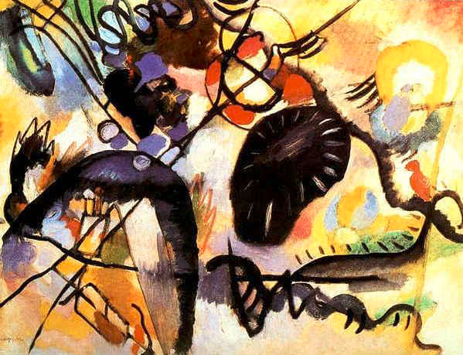
“Black Spot”, 1912

Slide 9
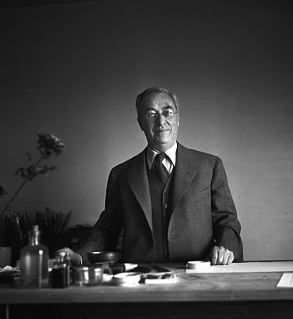
What is one thing you have learned today about
Wassily Kandinsky?

Slide 10
Kandinsky Circles
Write your name on the back of your paper.
Trace and cut out circles with construction paper. They do not need to be perfect circles.
Make some circles big and others small.
Glue your different circles to each other.
Trace some of your circles with oil pastels.
Repeat your design in a box like grid or place your circles randomly on the page.
Try to fill the space with circles, drawings of circles, or background color to hide the white.

Slide 11
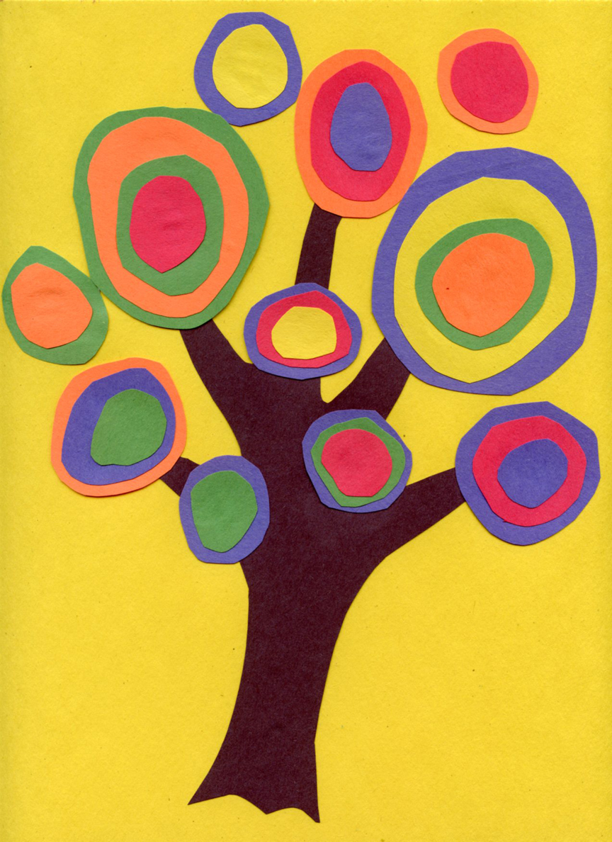
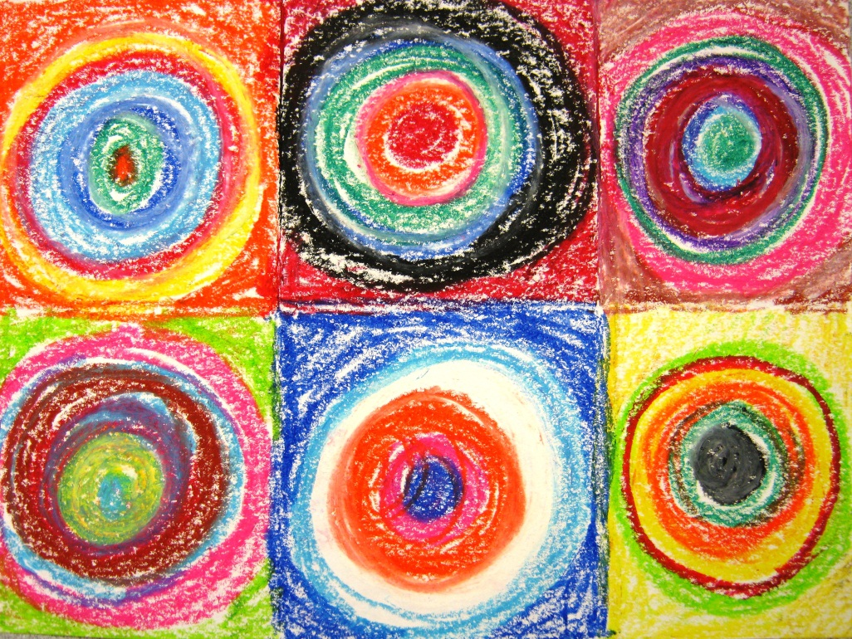
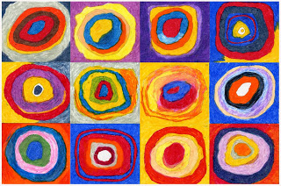
These are different types of “Kandinsky Circles” art projects you can choose from. You can also place your circles randomly on a sheet of black construction paper to model after the art on slide #7. You can use construction paper, markers, oil pastels or even crayon!

